Slide 1


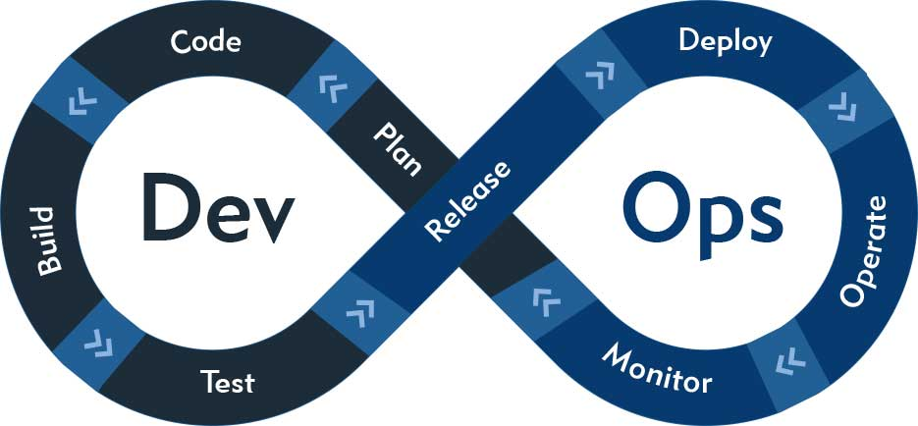

Major Project AWS CI/CD Pipeline
Presented By:-
Lakshya Soni
Presented To:-
Nitin Sir

Slide 2
INDEX
Developer Code
AWS CodeCommit
IAM User
AWS CodeBuild
Amazon Artifact and S3
Amazon CodeDeploy
Amazon EC2
AWS CodePipeline

Slide 3
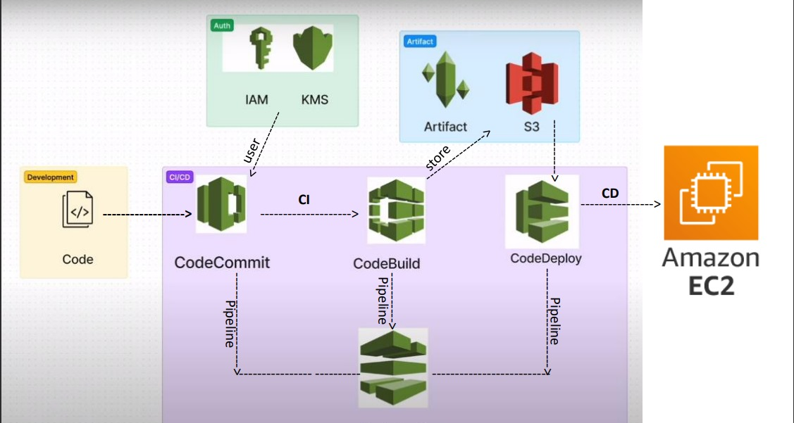
CI/CD Pipeline

Slide 4
What is CI/CD Pipeline?
A continuous integration and continuous deployment (CI/CD) pipeline is a series of steps that must be performed in order to deliver a new version of software. CI/CD pipelines are a practice focused on improving software delivery throughout the software development life cycle via automation.

Slide 5
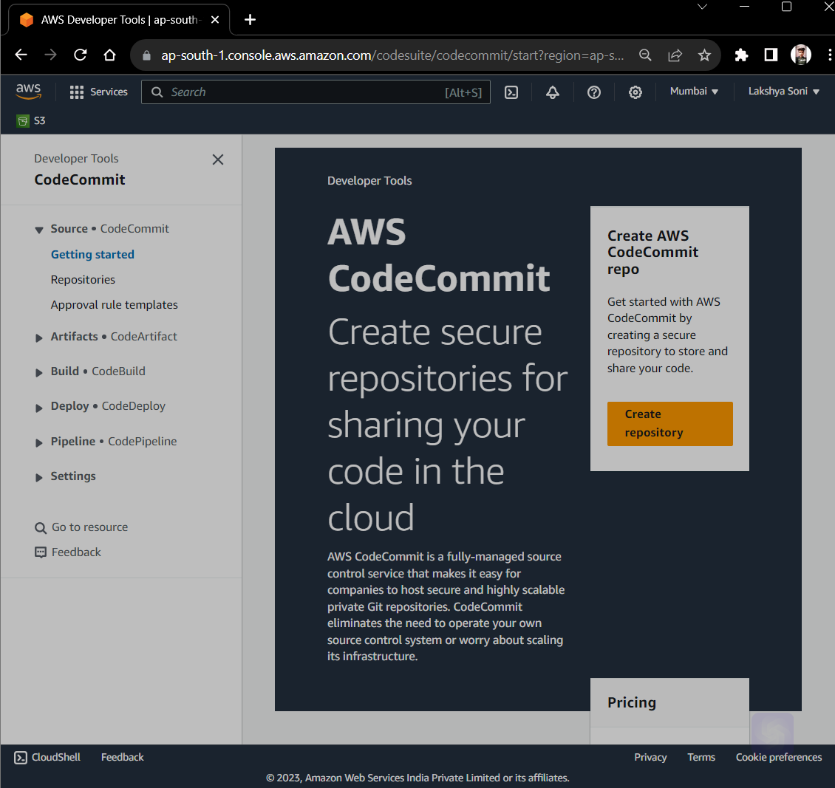
Create Repository from AWS CodeCommit

Slide 6
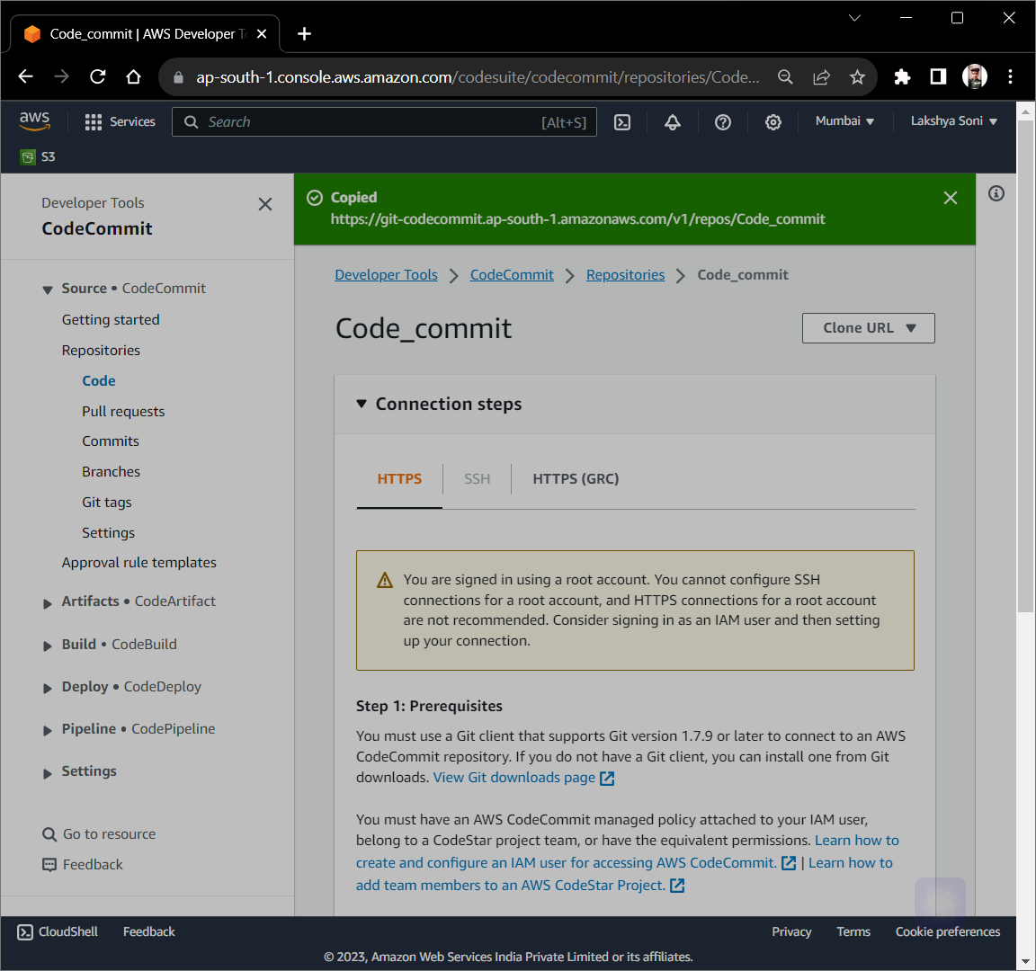

Slide 7
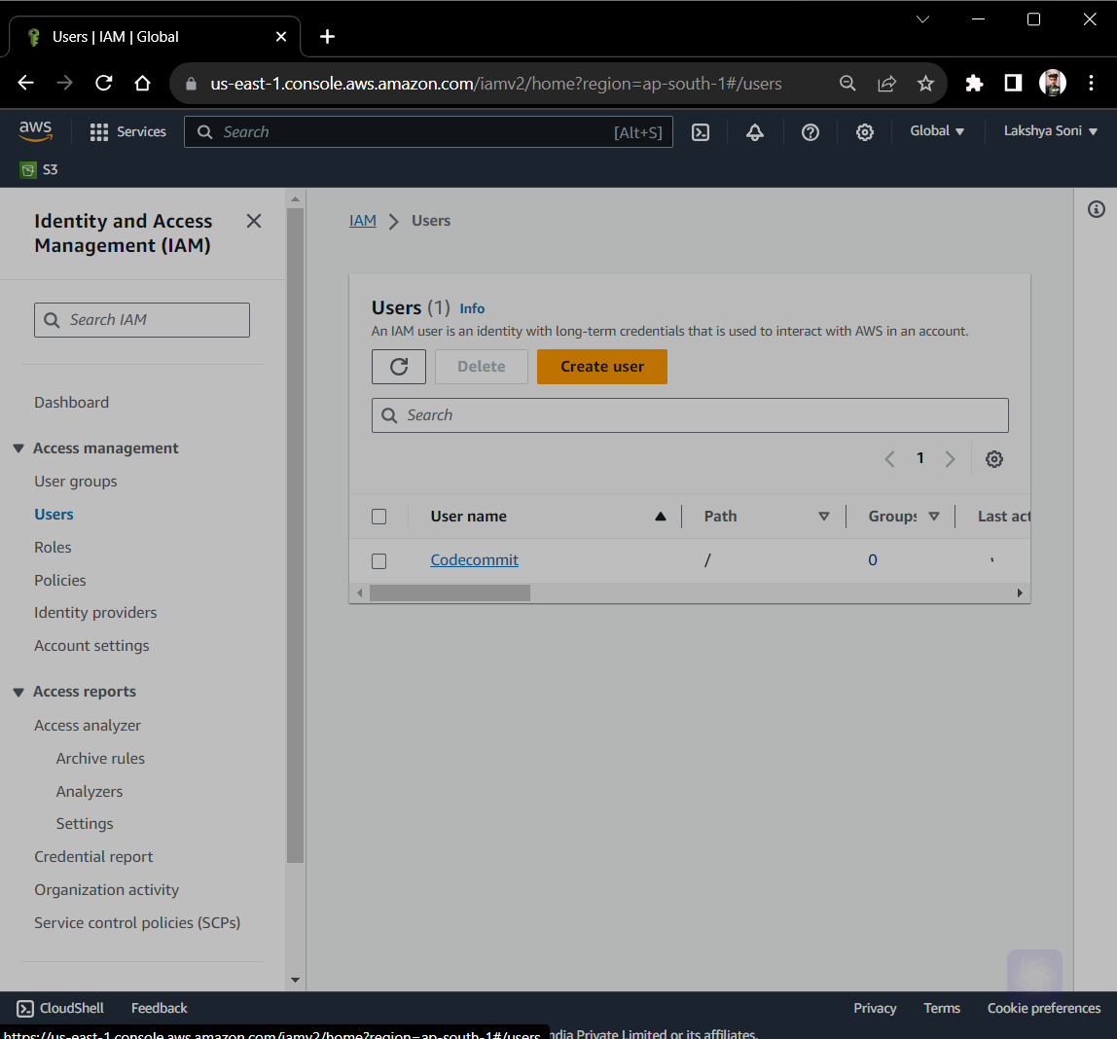
Create IAM User

Slide 8
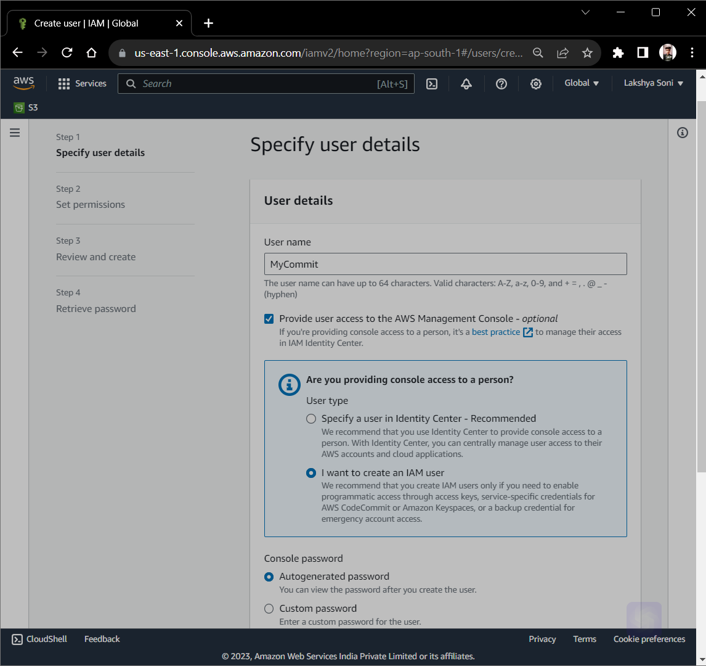

Slide 9
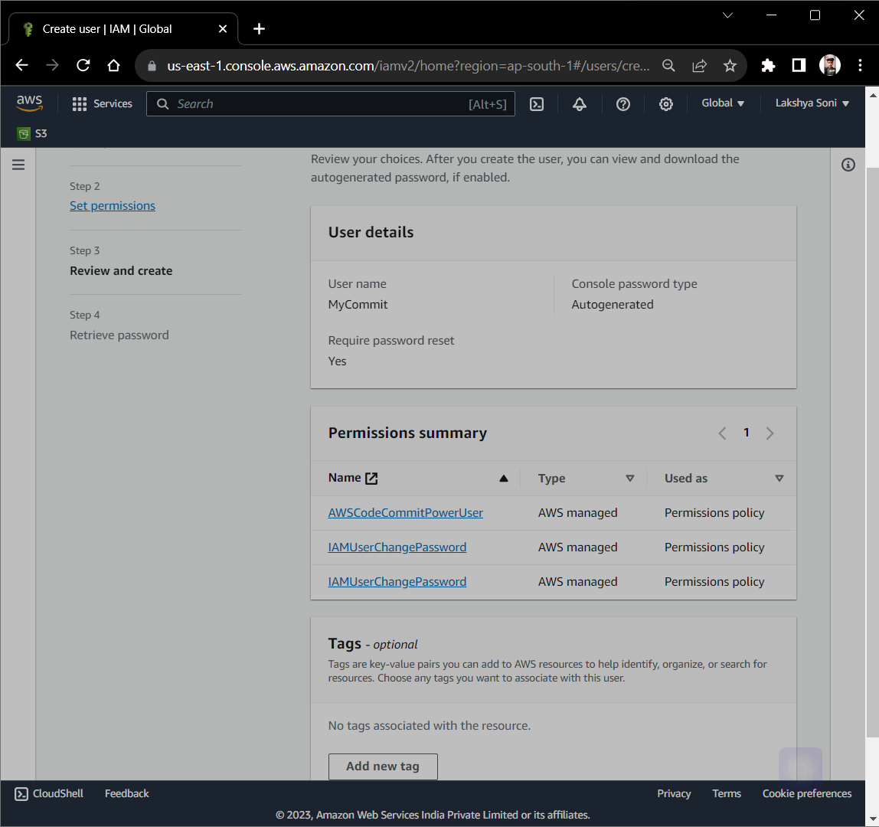
Give Permission PowerUser of AWS CodeCommit

Slide 10
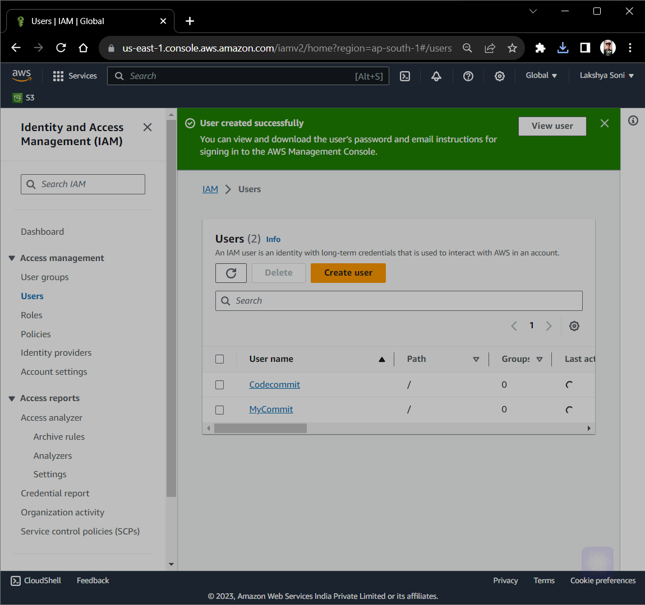

Slide 11
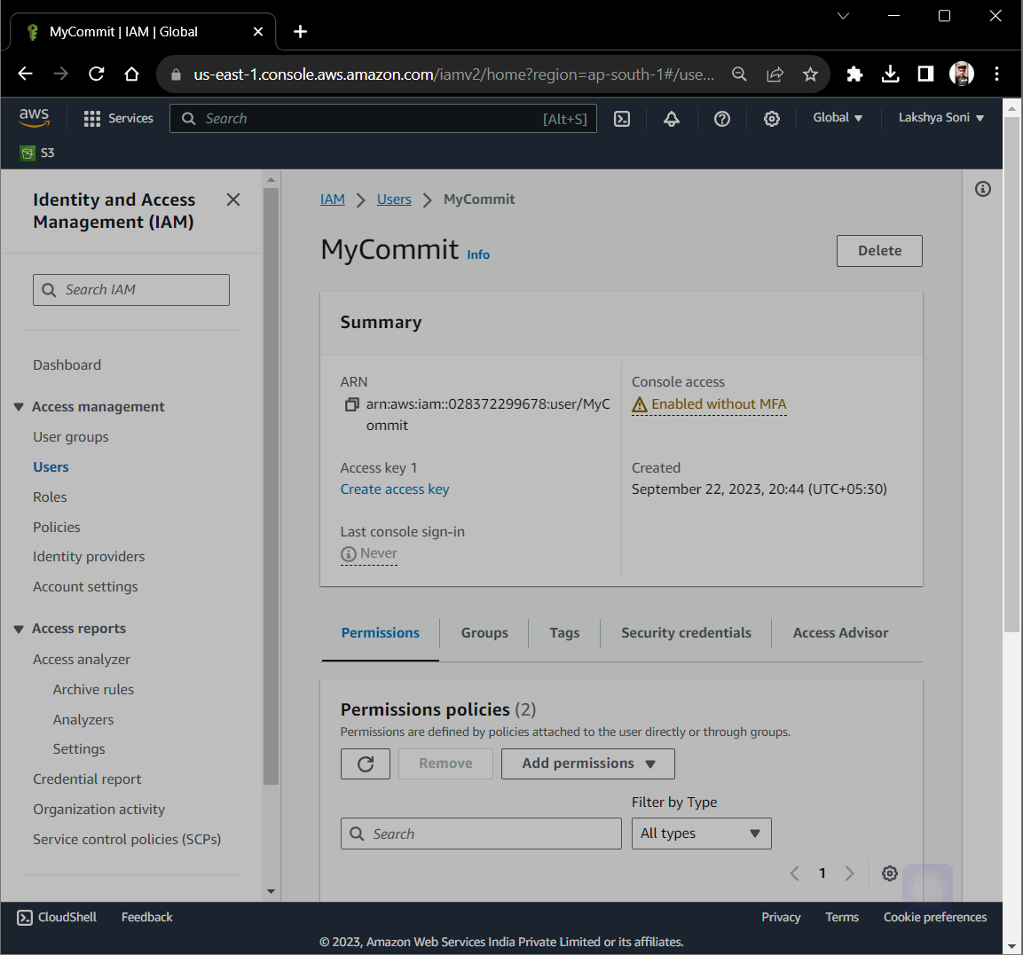

Slide 12
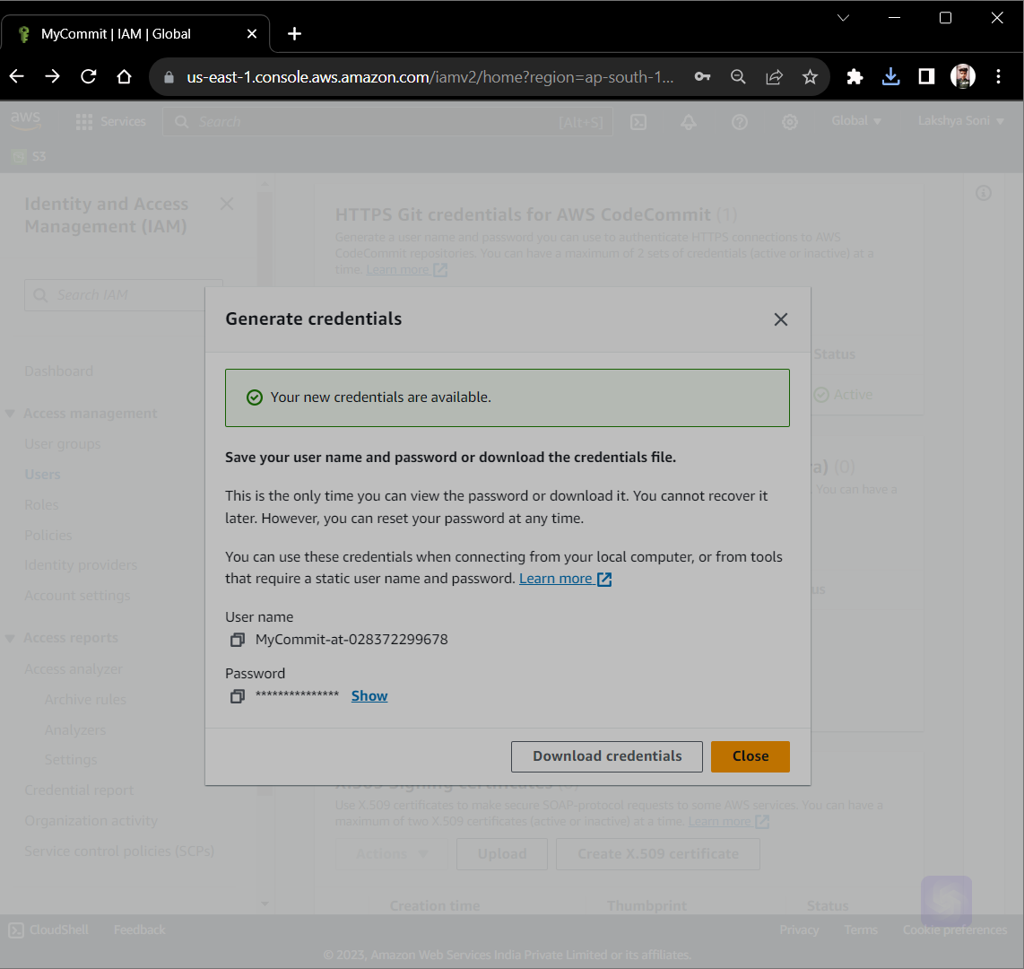

Slide 13
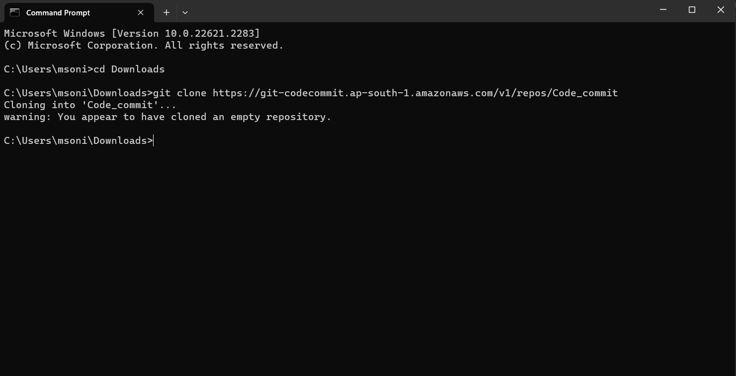
Connect with local host

Slide 14
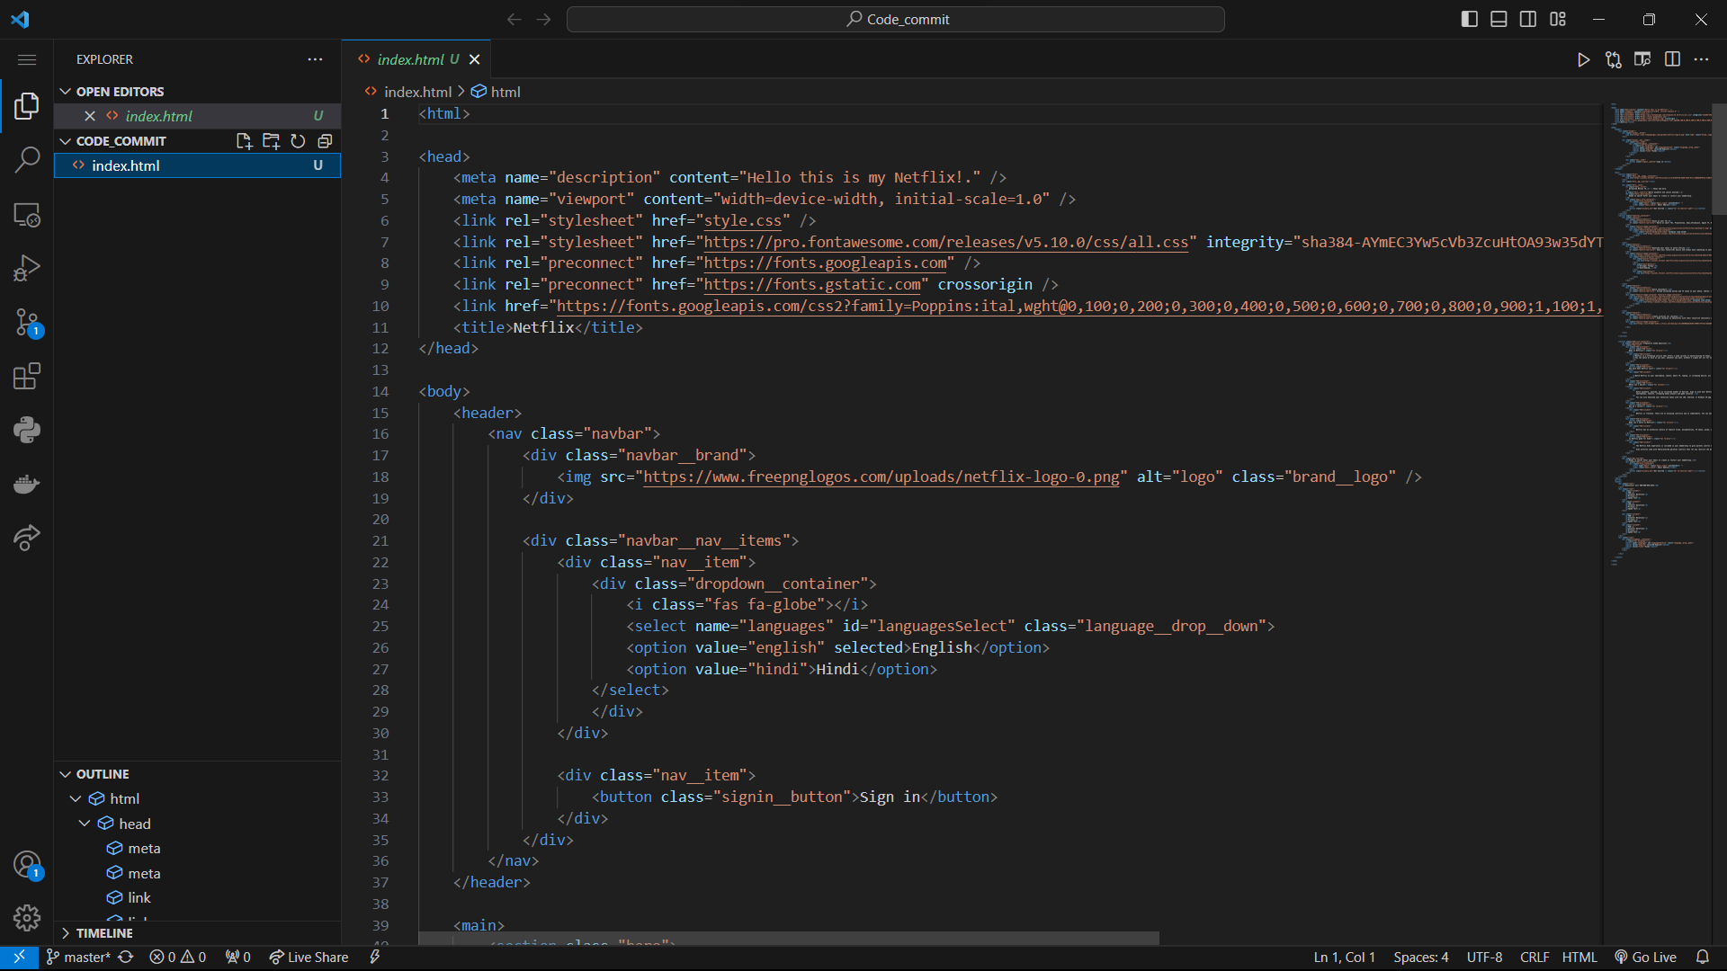
Add Code File in Codecommit Folder

Slide 15
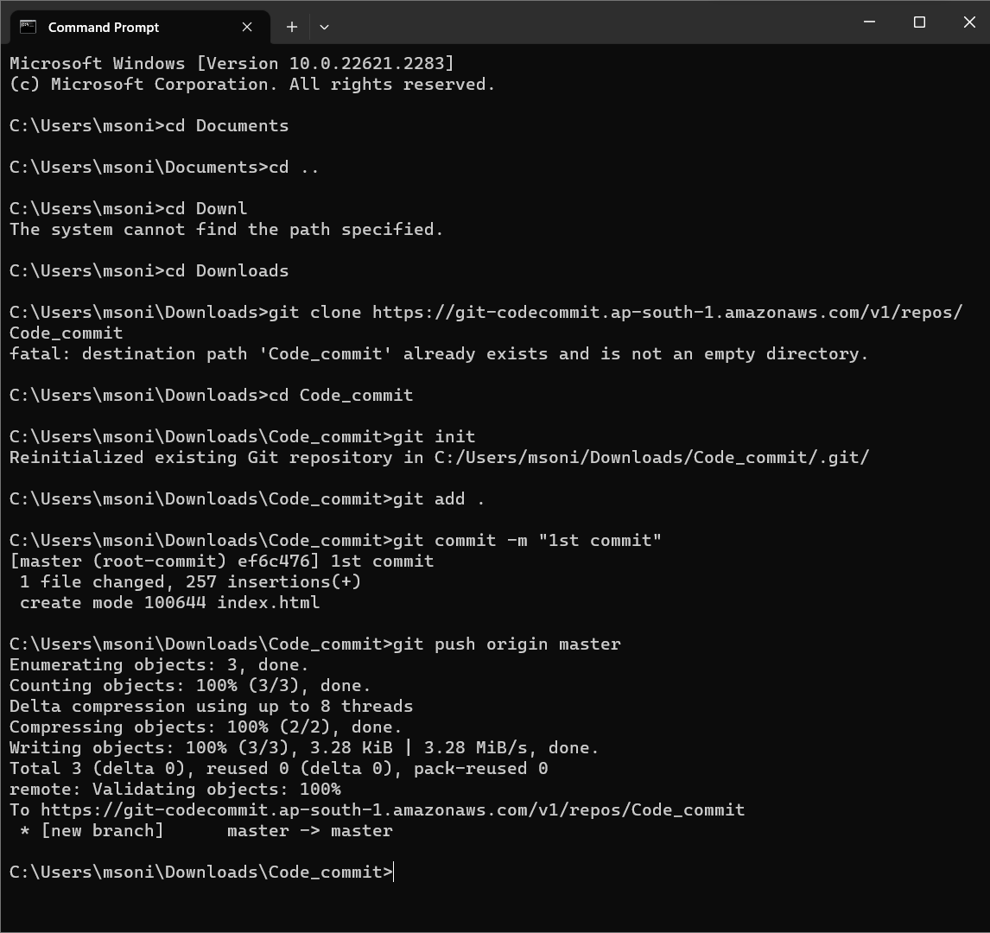
Push code file to the repository

Slide 16
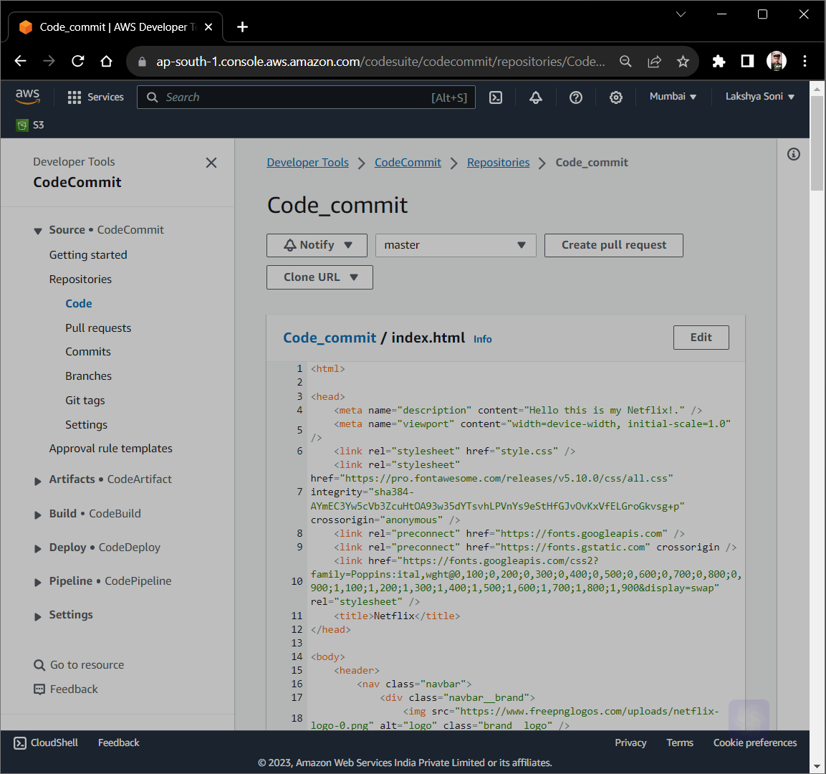

Slide 17
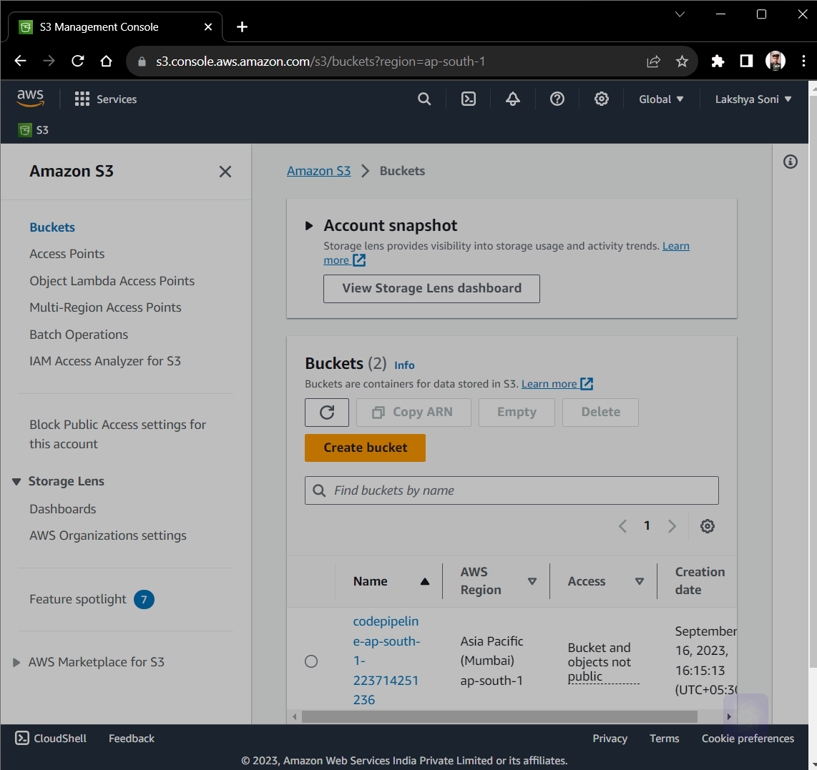
Create Bucket of Amazon S3

Slide 18
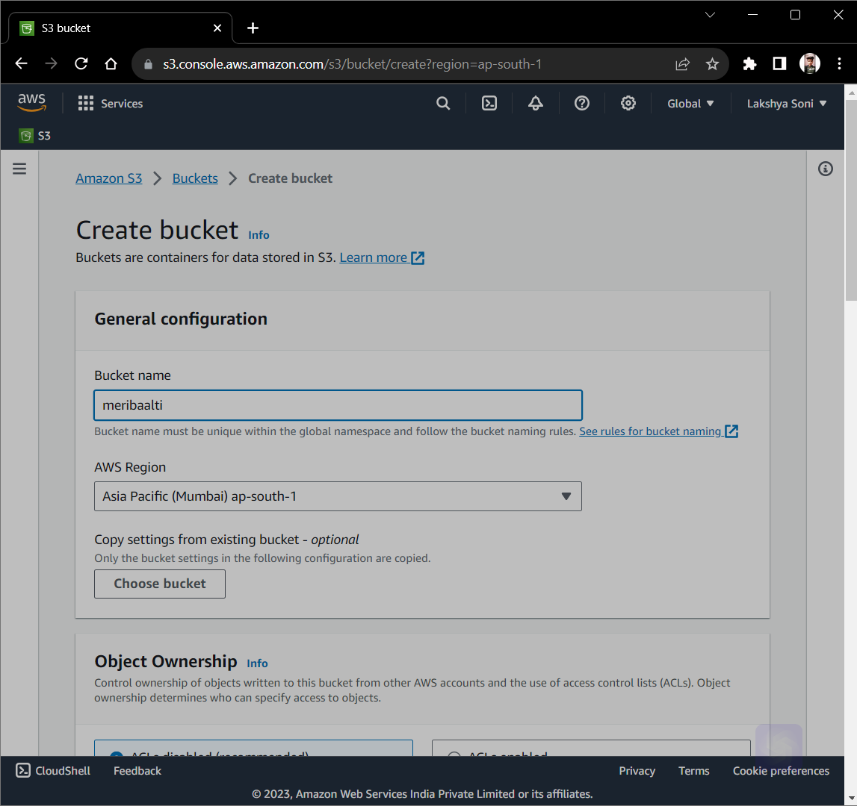

Slide 19
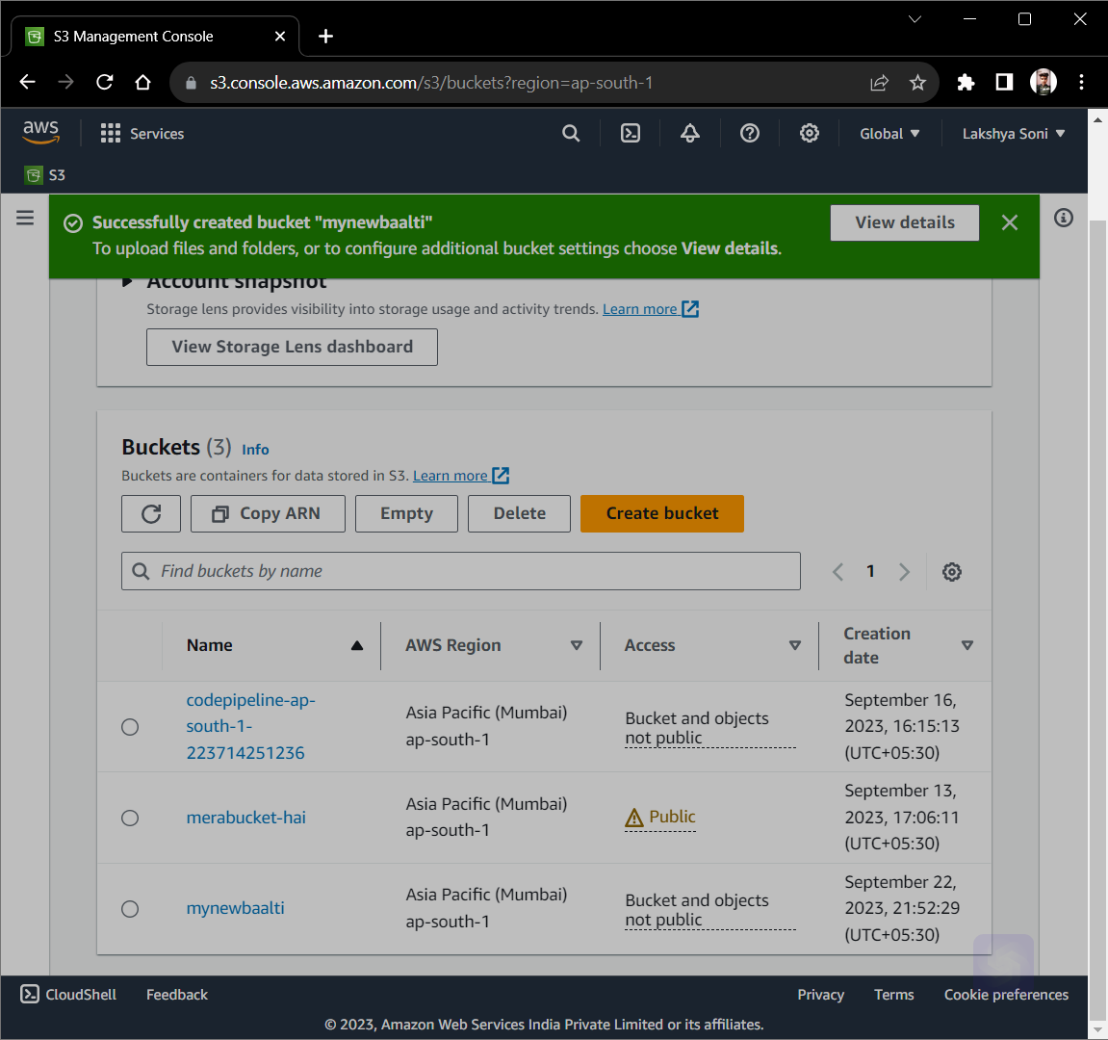

Slide 20
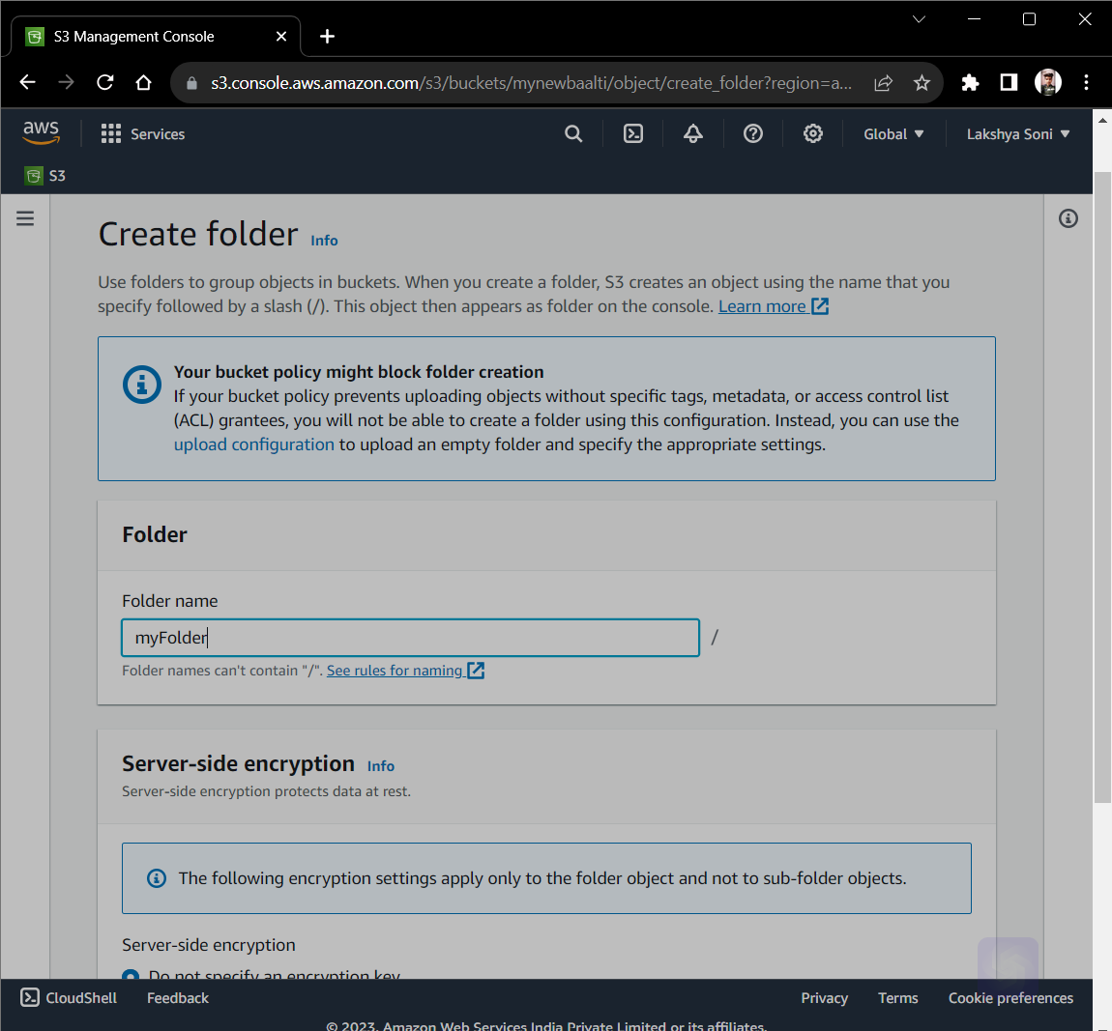

Slide 21
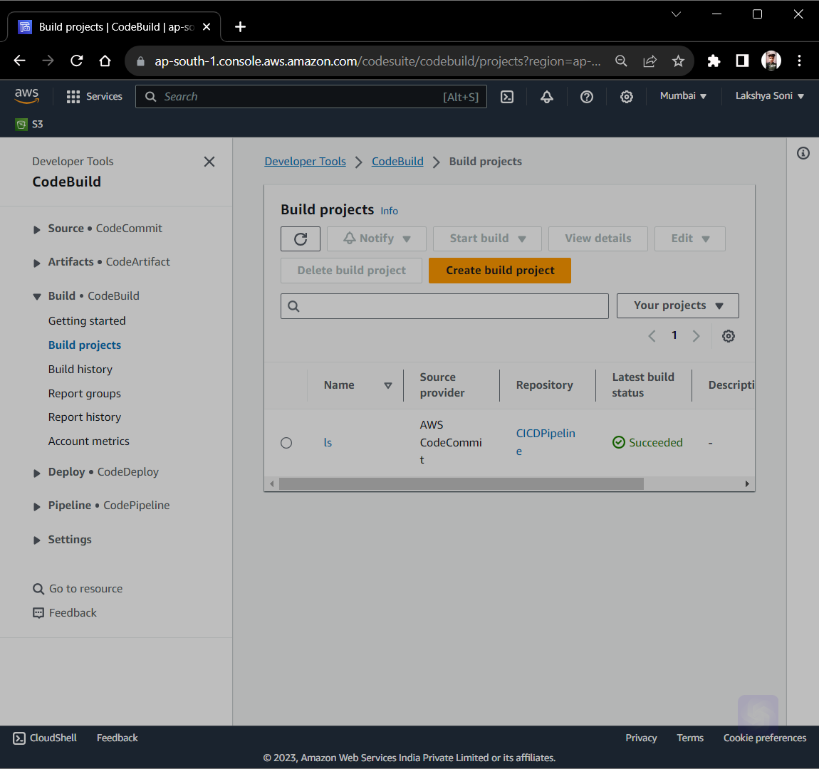
Create Build from AWS CodeBuild

Slide 22
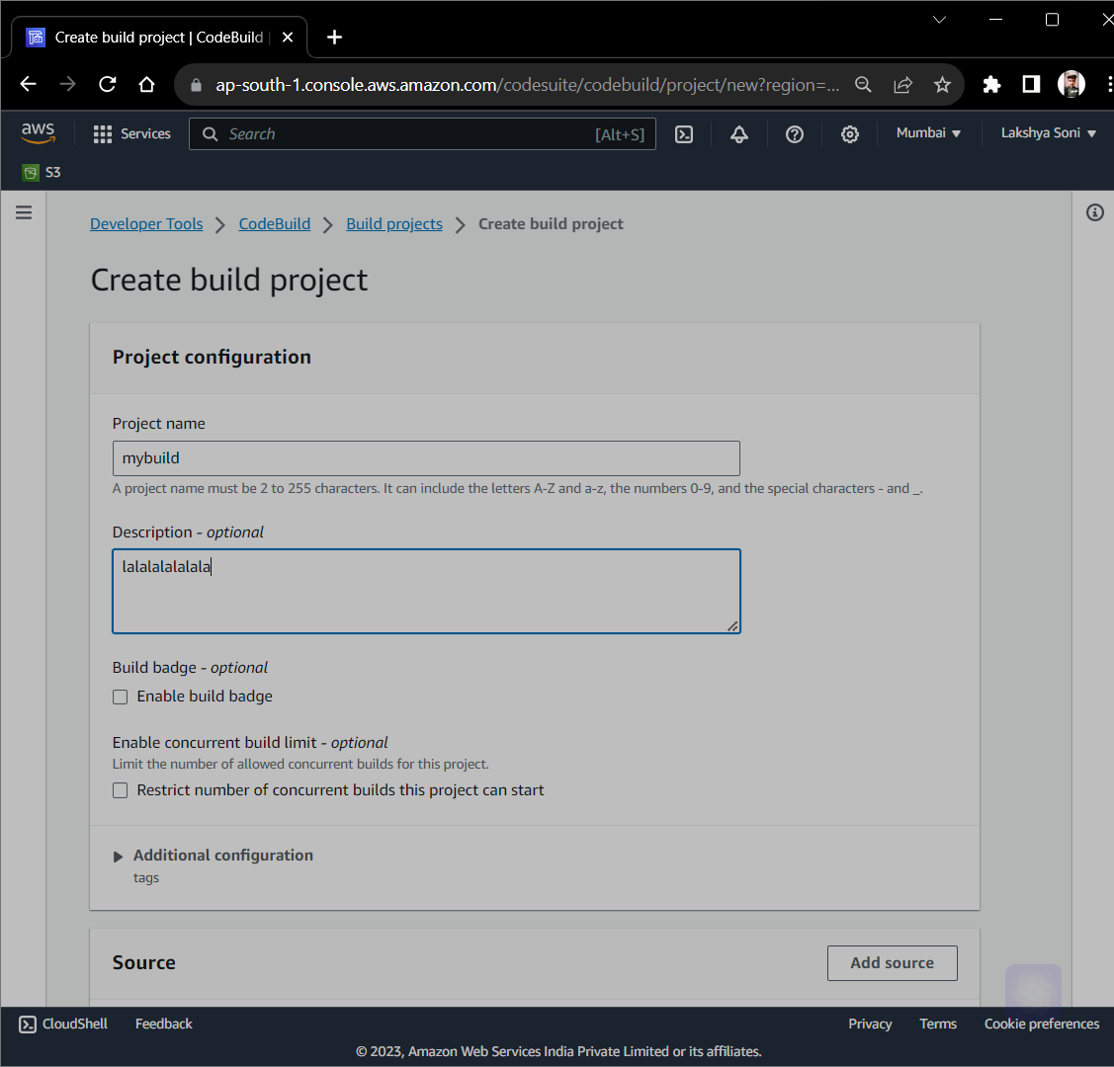

Slide 23
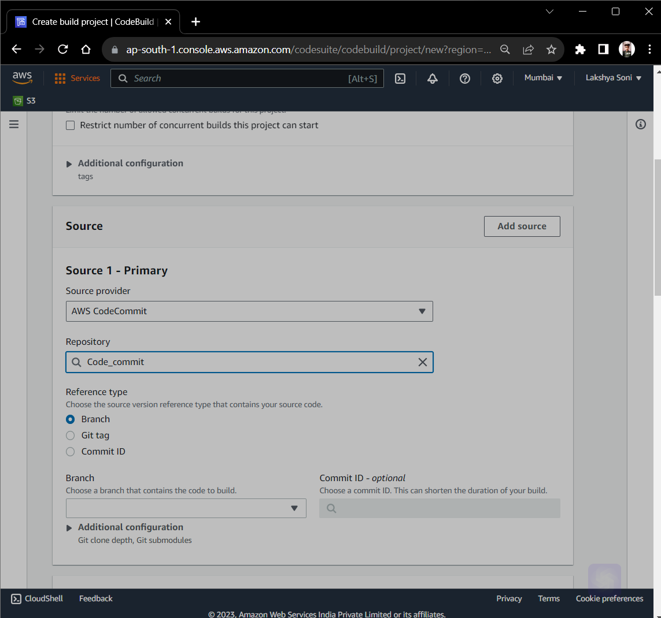

Slide 24
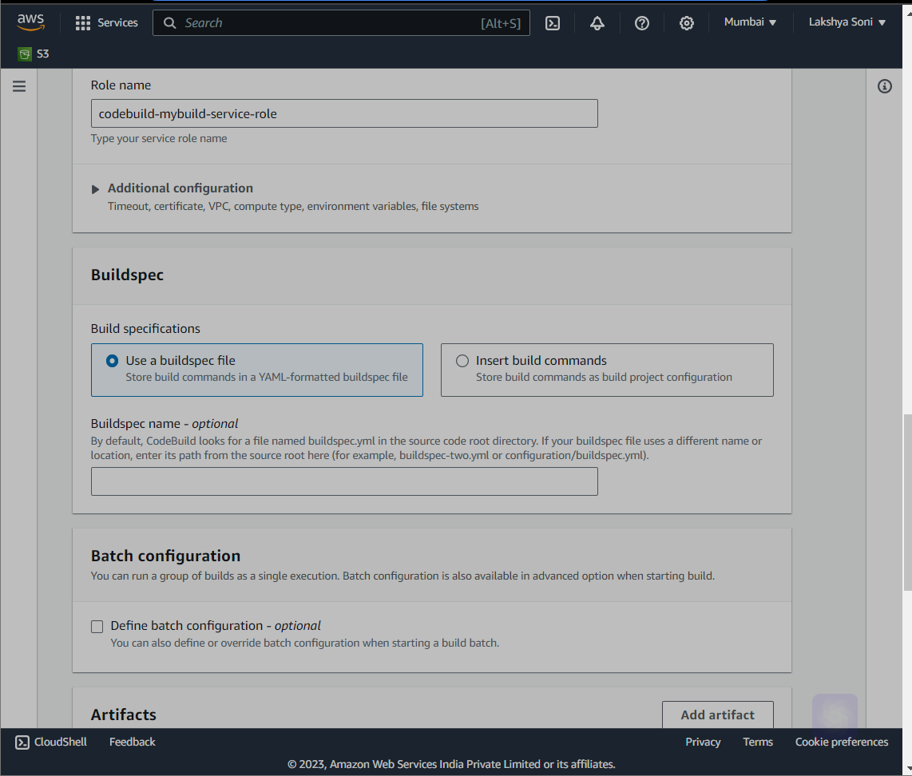

Slide 25
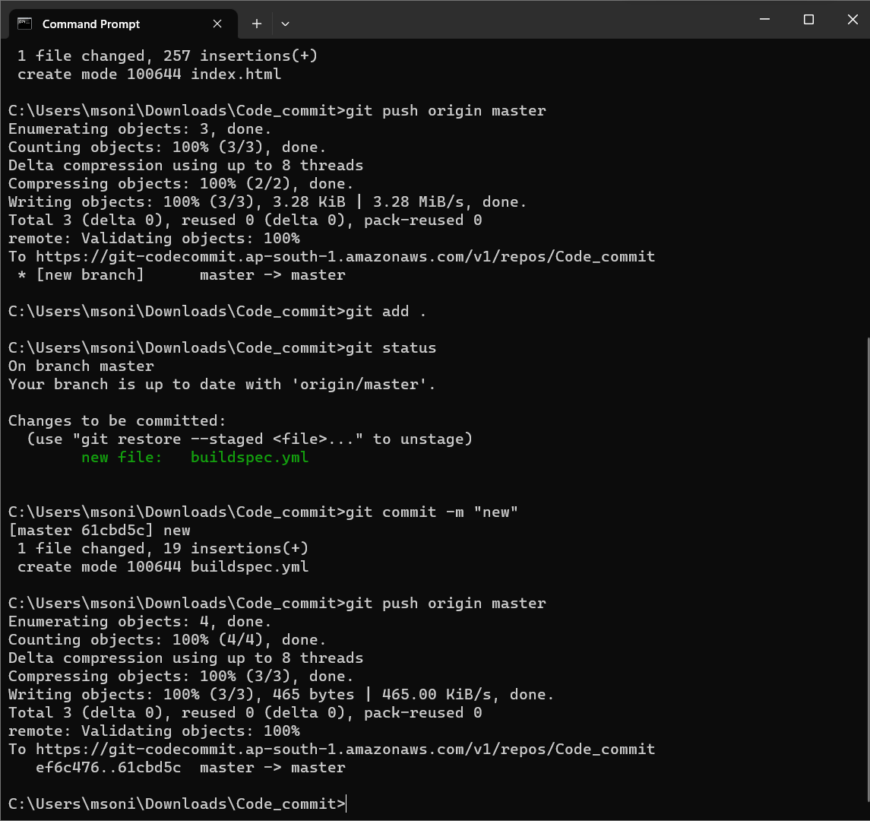

Slide 26
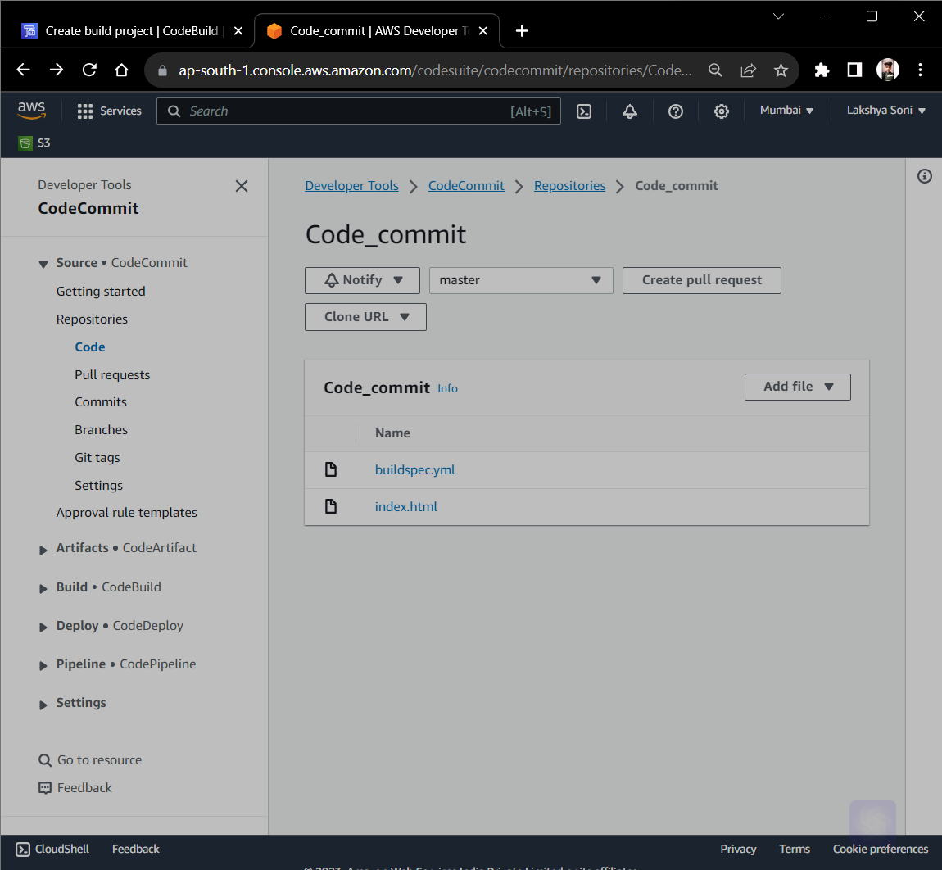

Slide 27
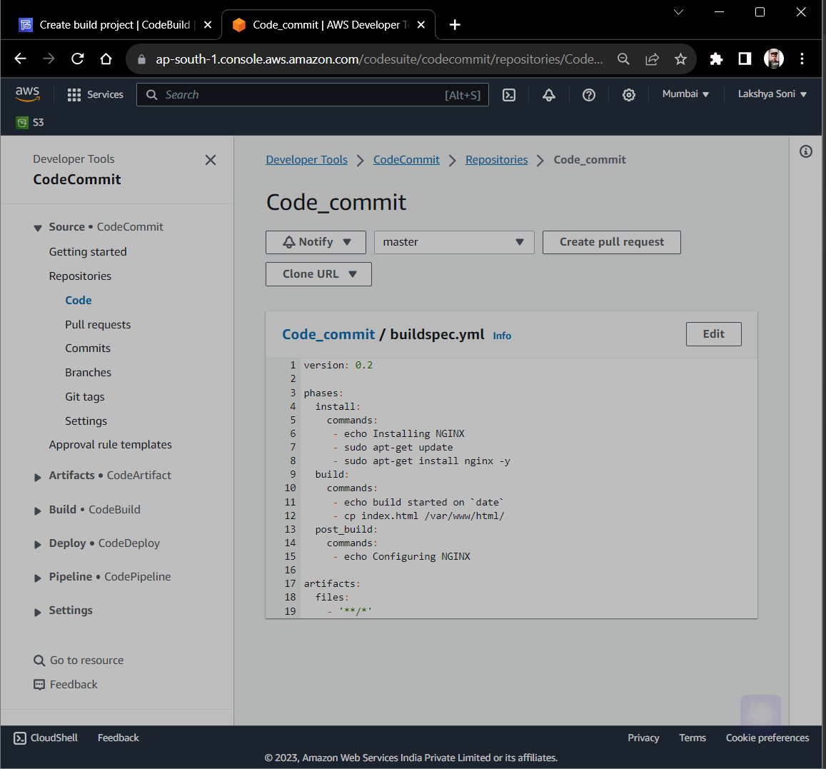

Slide 28
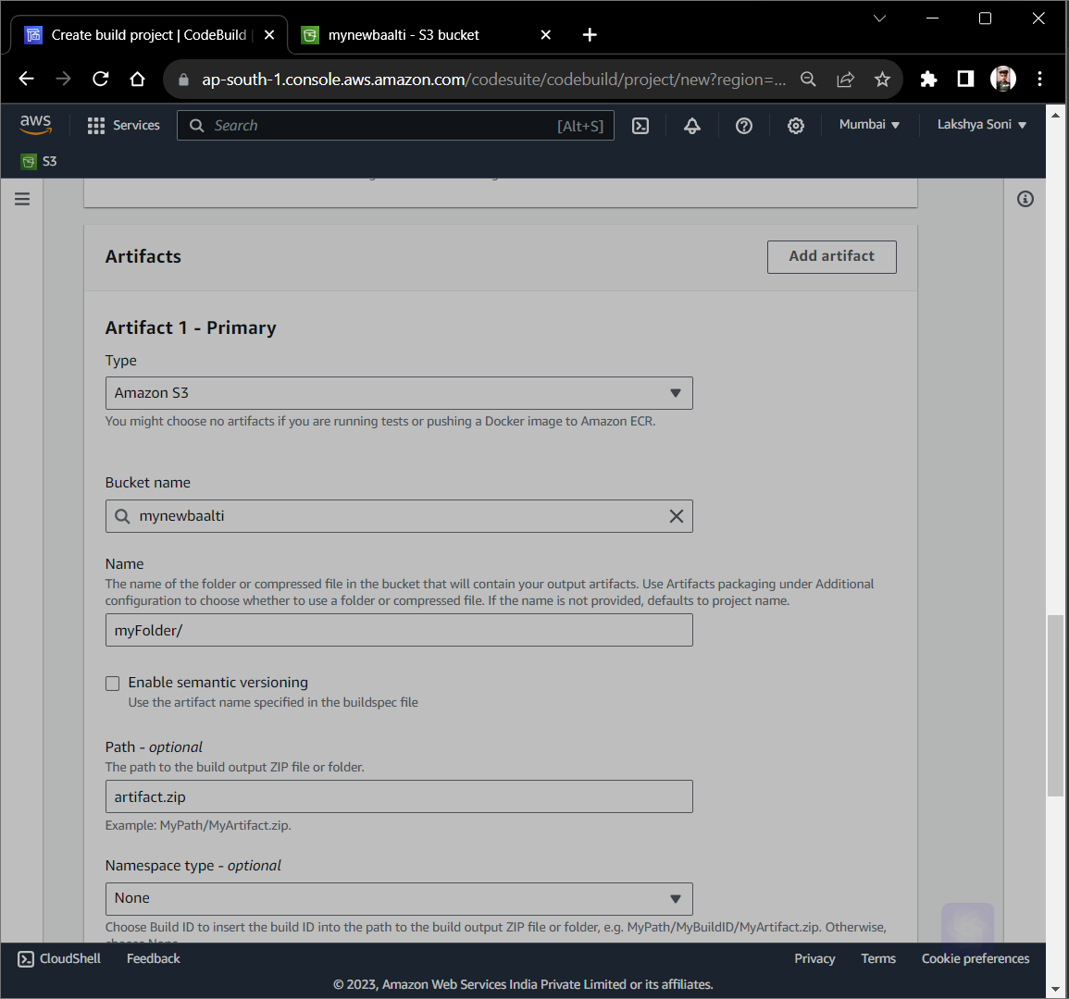

Slide 29
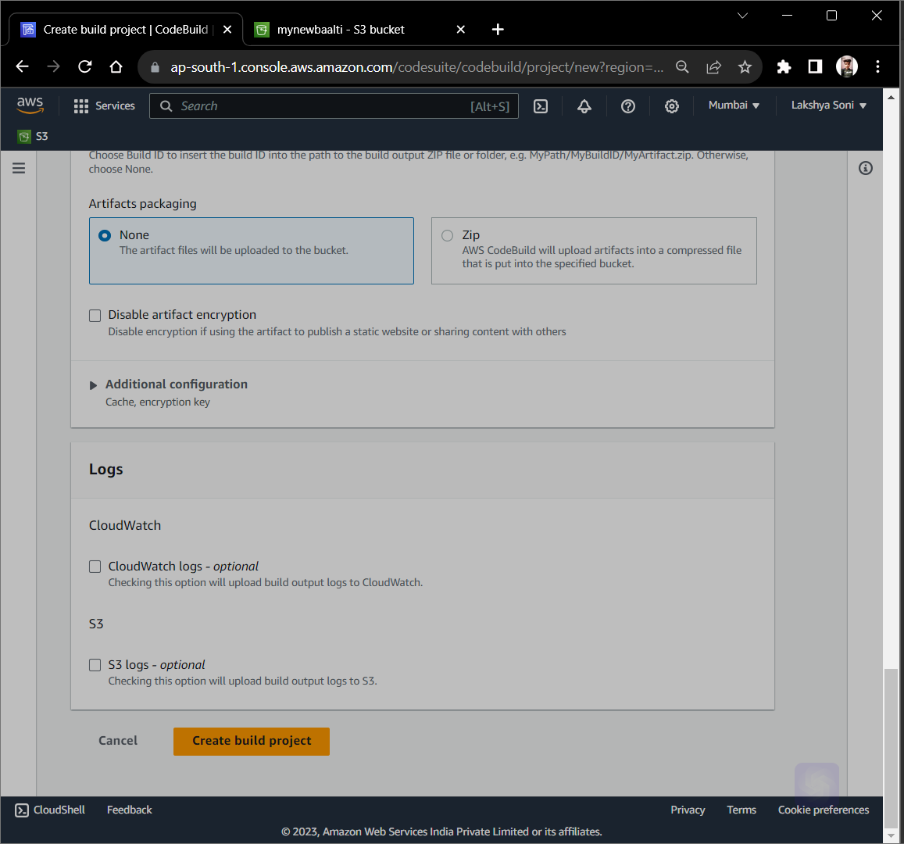

Slide 30
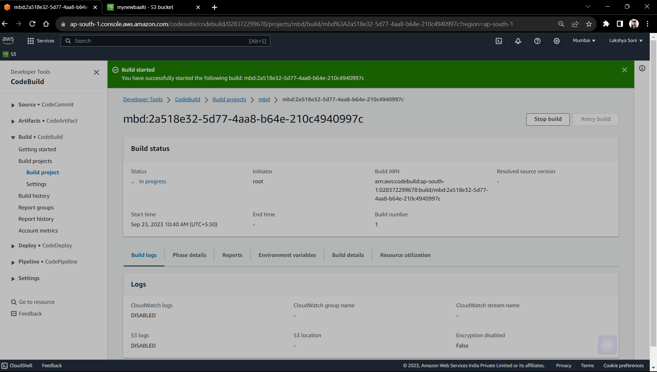

Slide 31
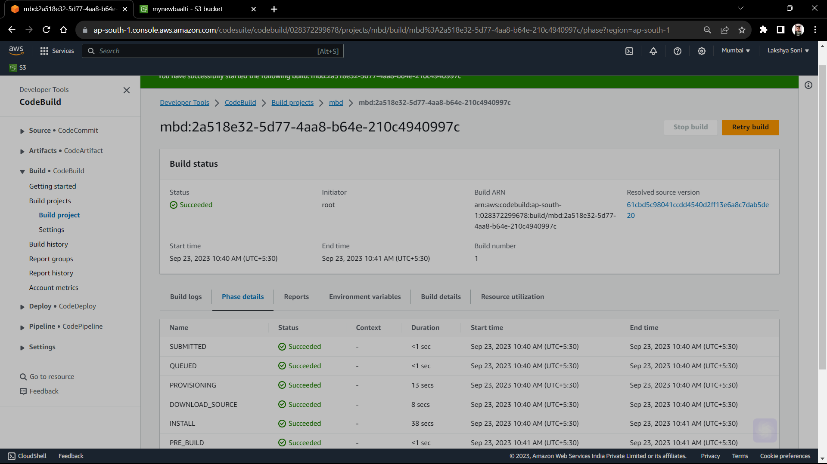

Slide 32
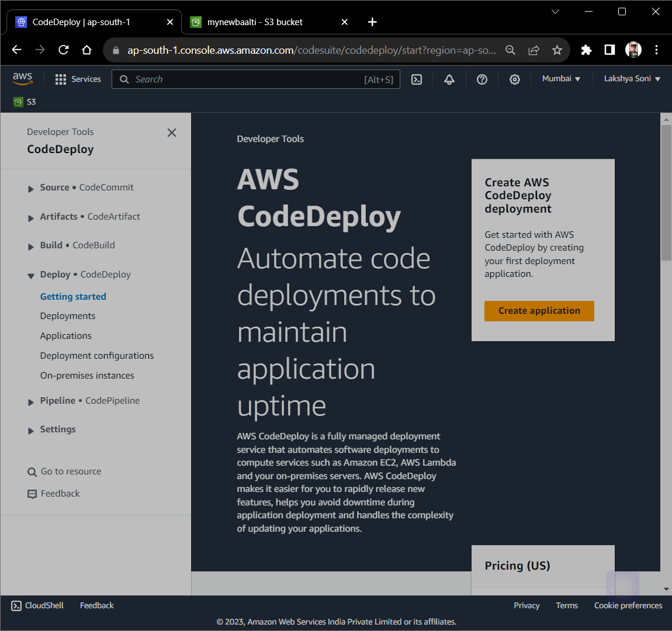
Create Application from AWS CodeDeploy

Slide 33
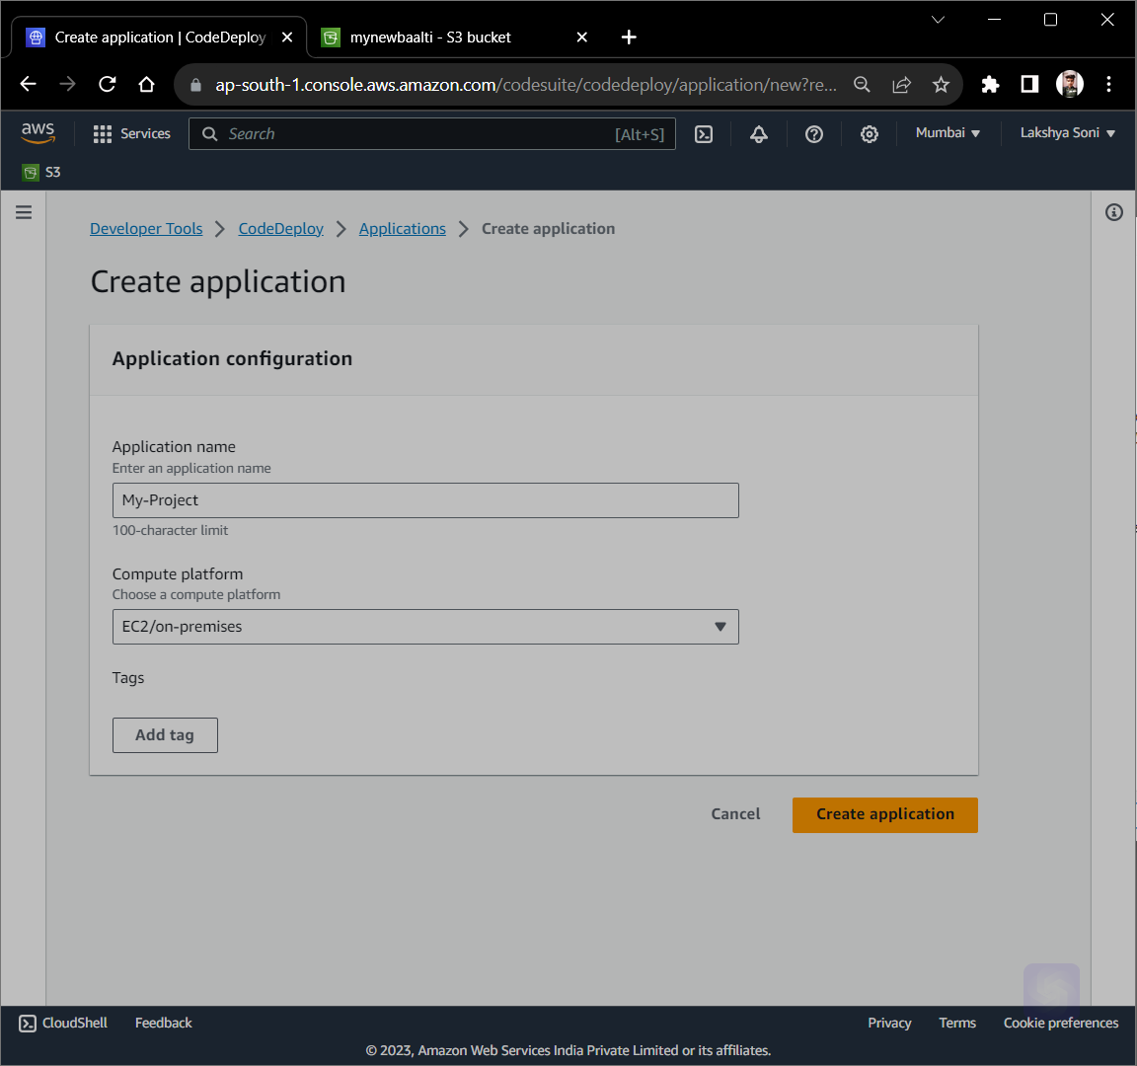

Slide 34
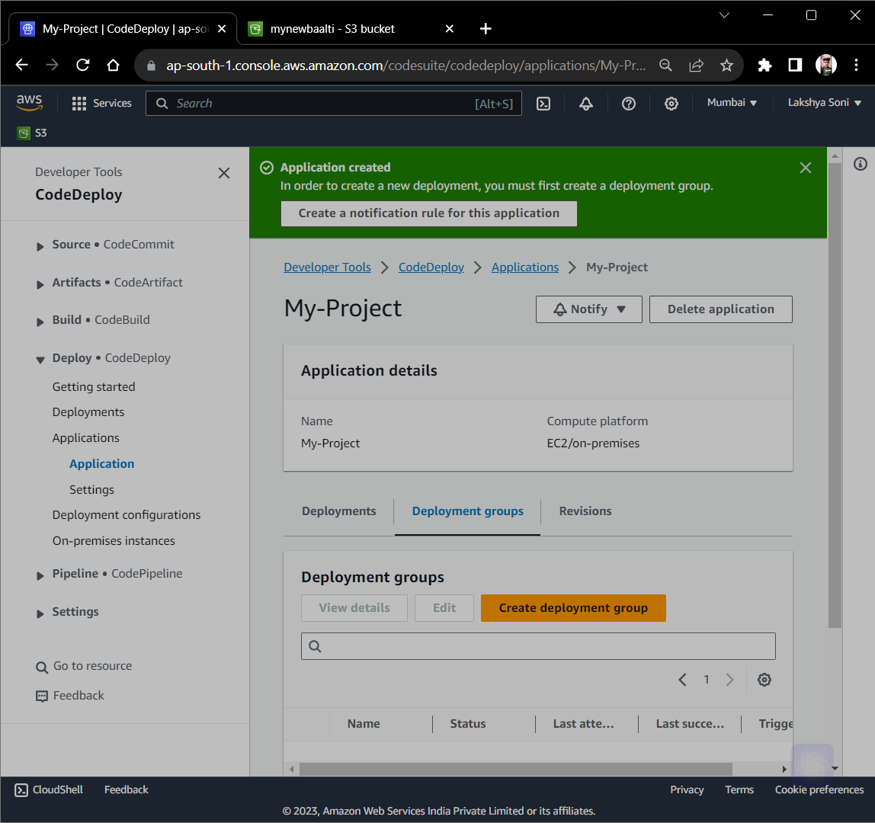

Slide 35
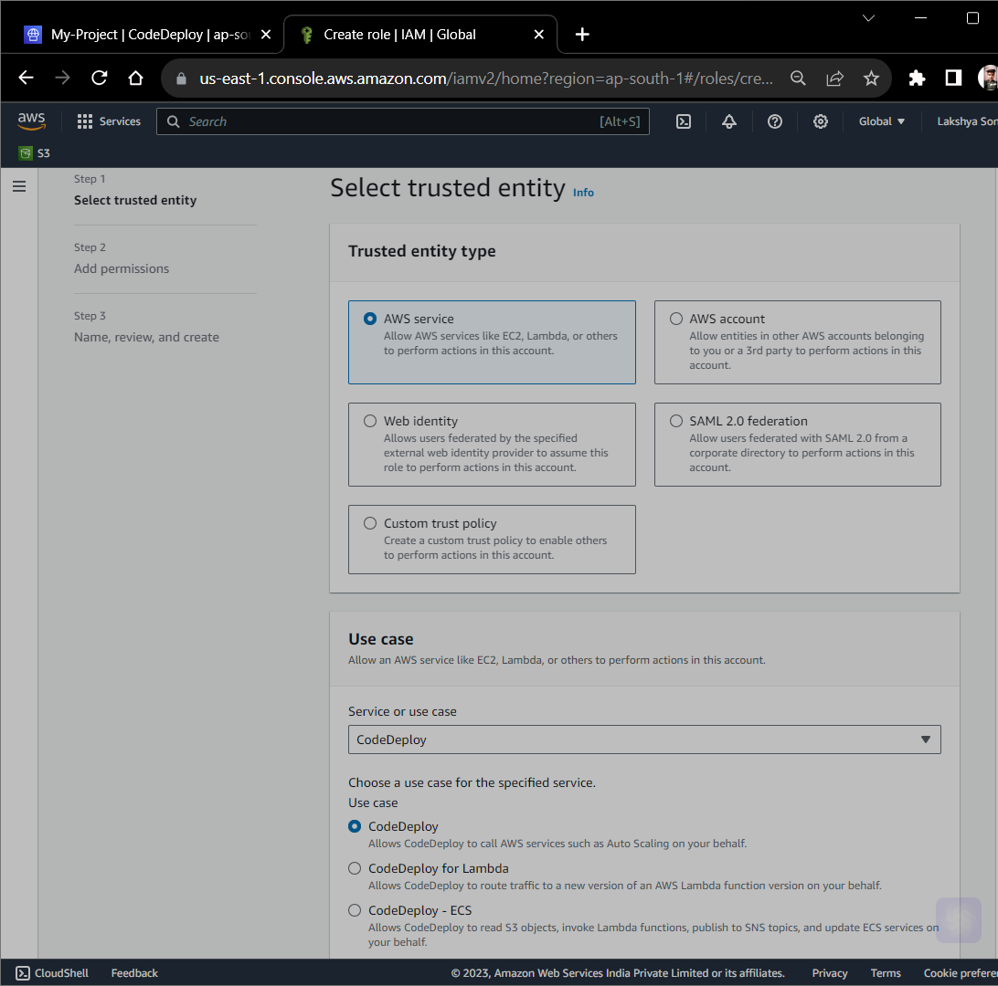
Create Role for CodeDeploy

Slide 36
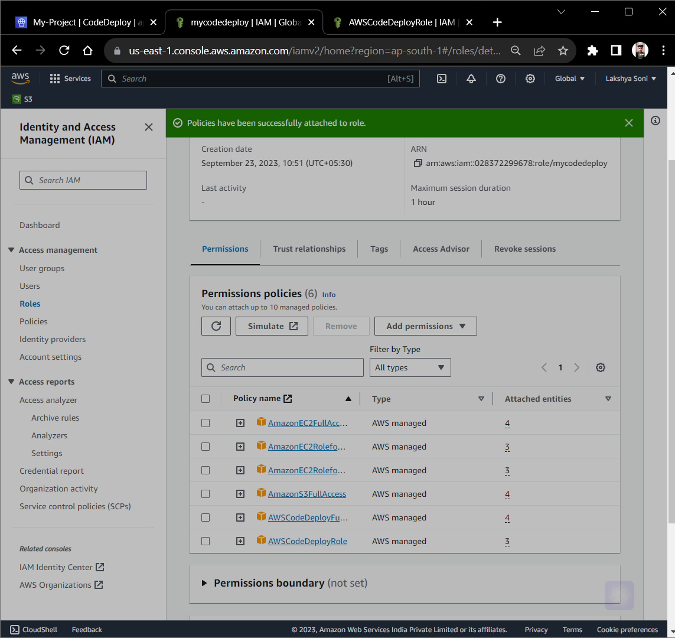

Slide 37
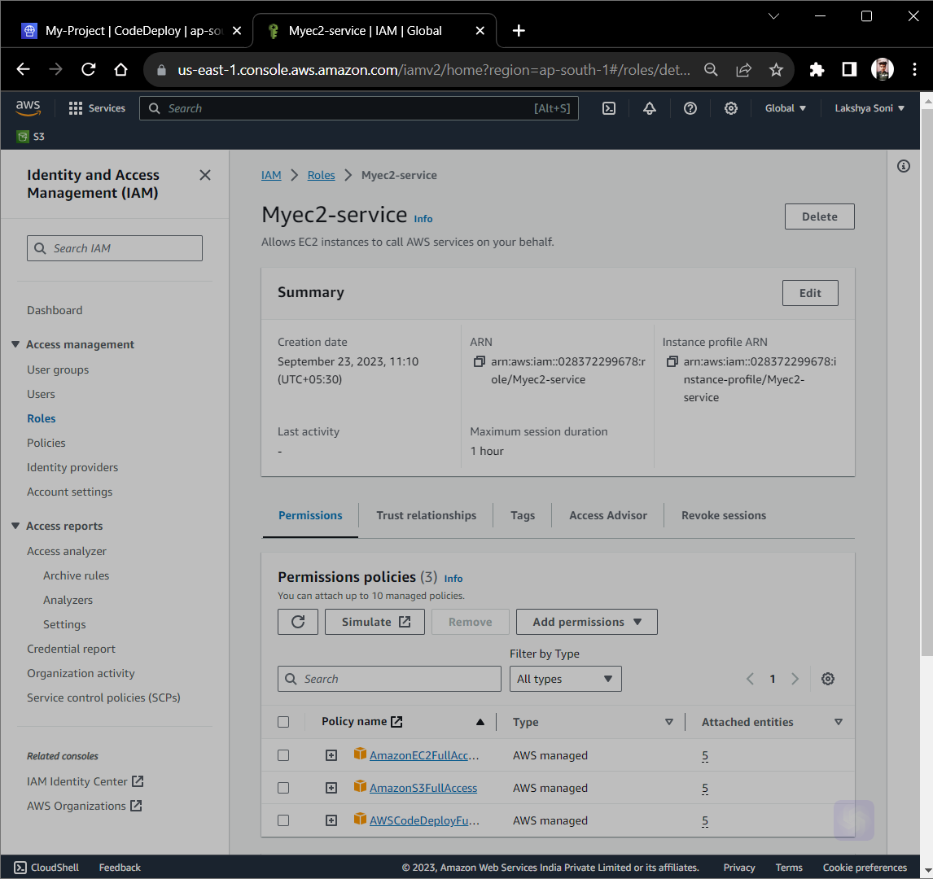
Create Role for Amazon EC2

Slide 38
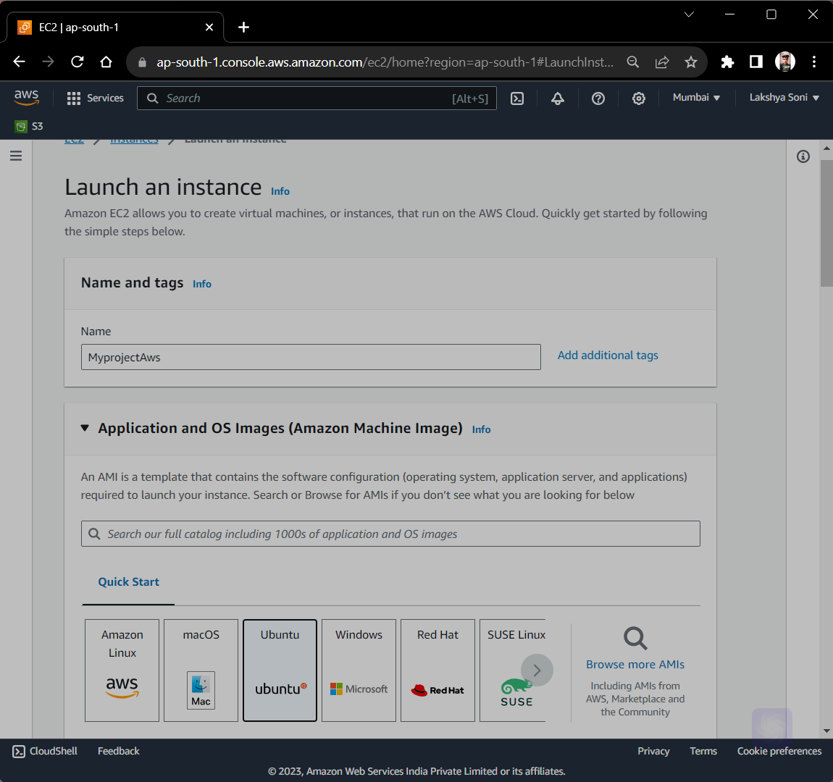
Create Ubuntu Machine

Slide 39
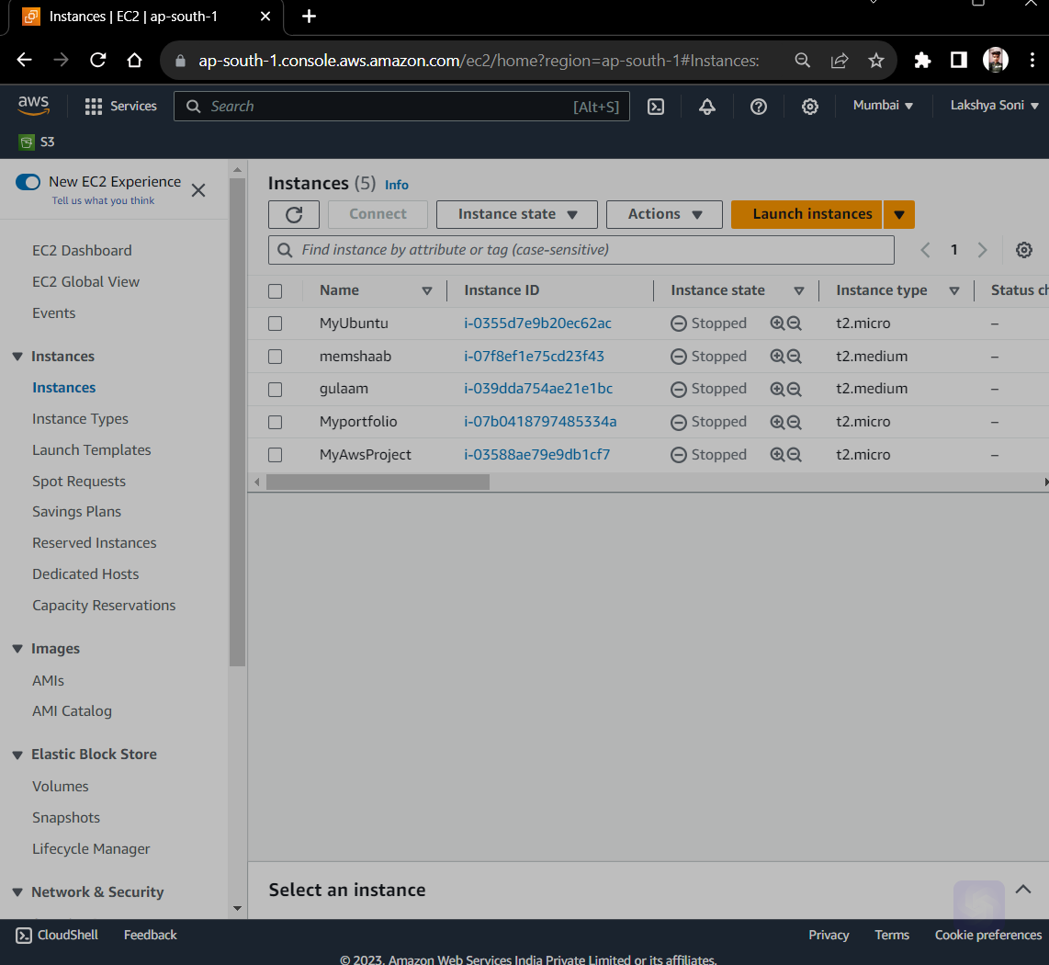

Slide 40
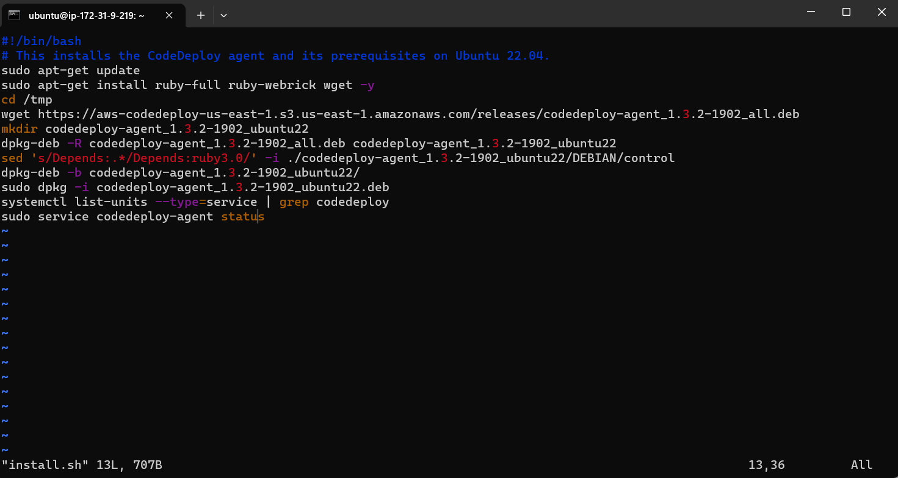
Connect Ubuntu Instance and write script

Slide 41
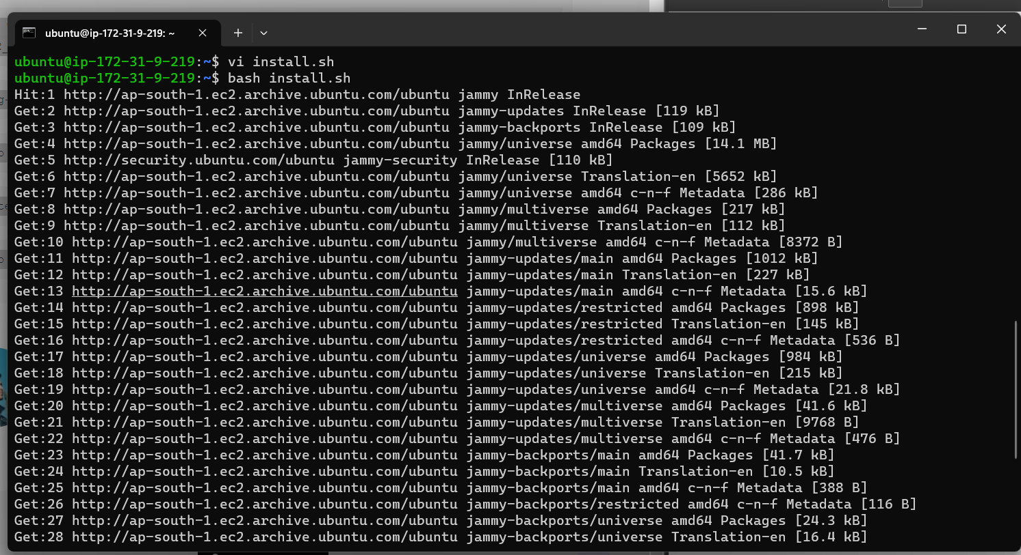

Slide 42
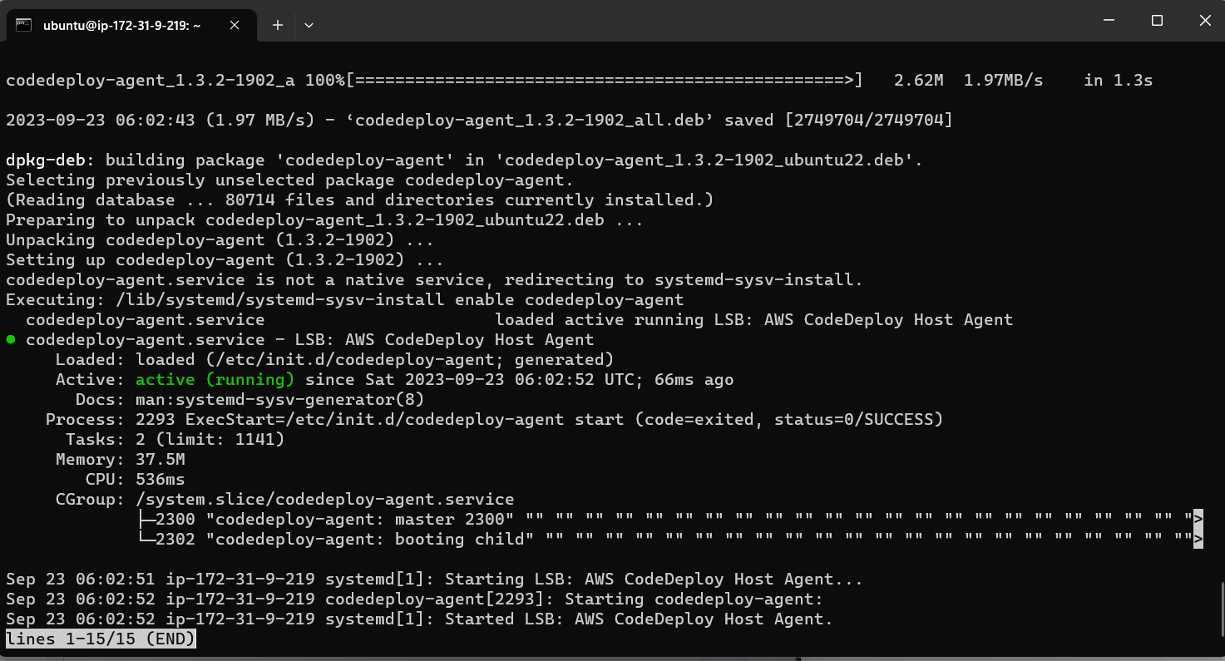

Slide 43
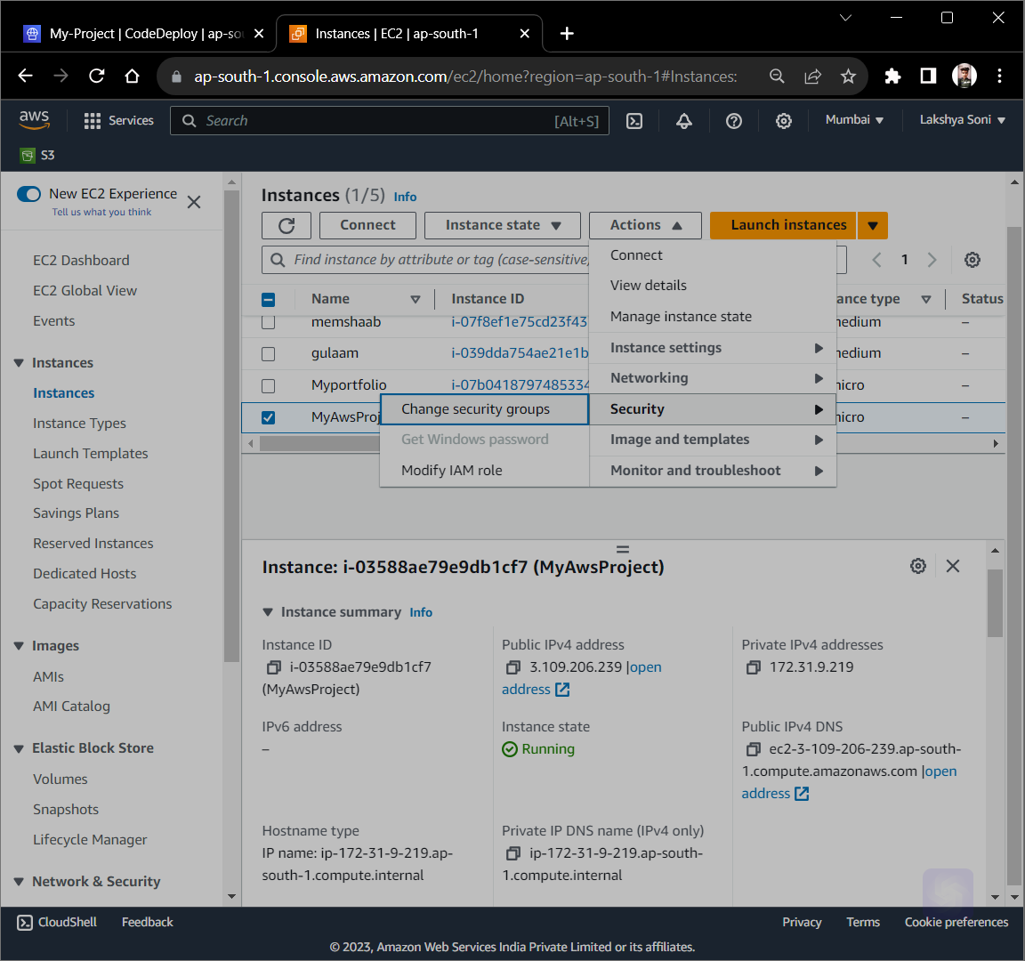

Slide 44
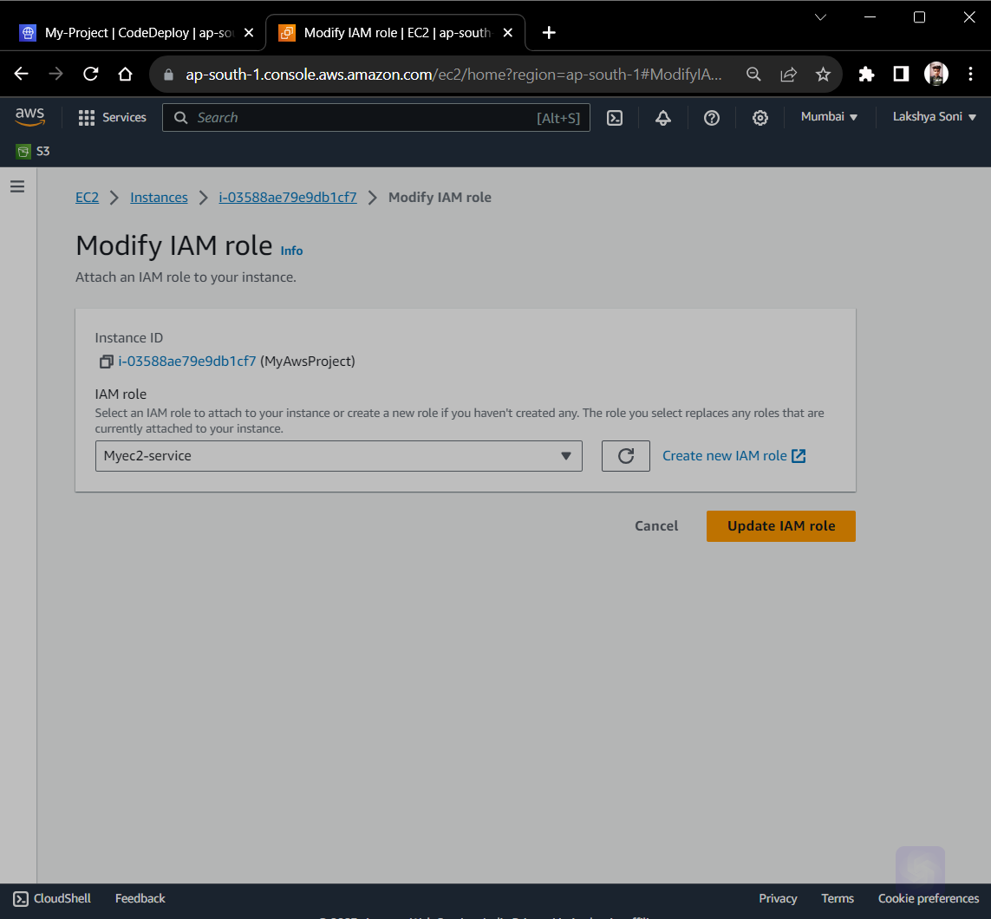

Slide 45
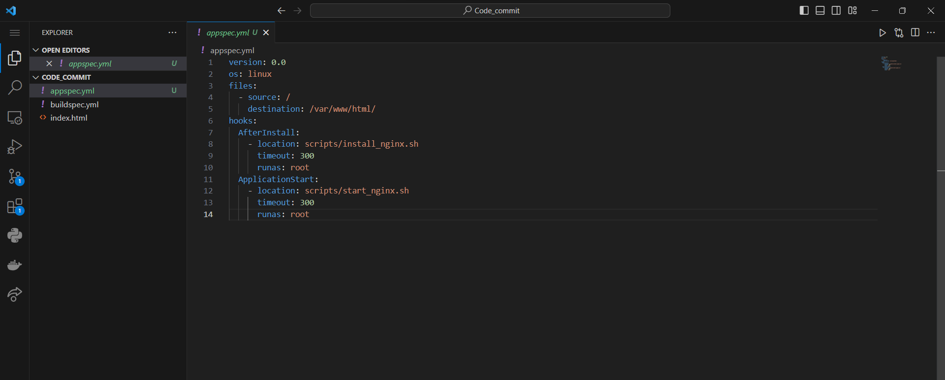
Create Appspec.yml file

Slide 46
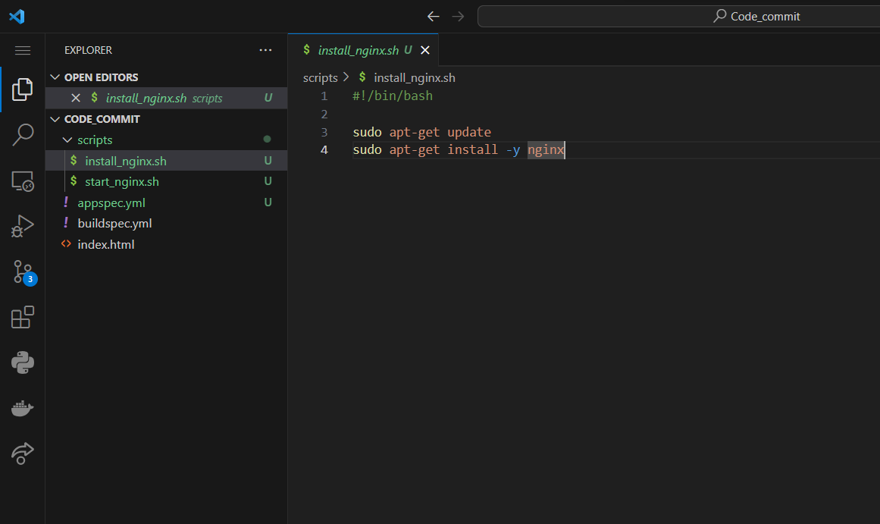
Add scripts

Slide 47
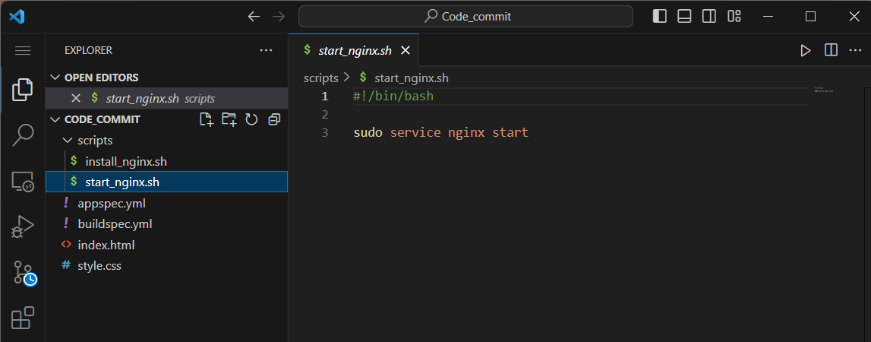


Slide 48
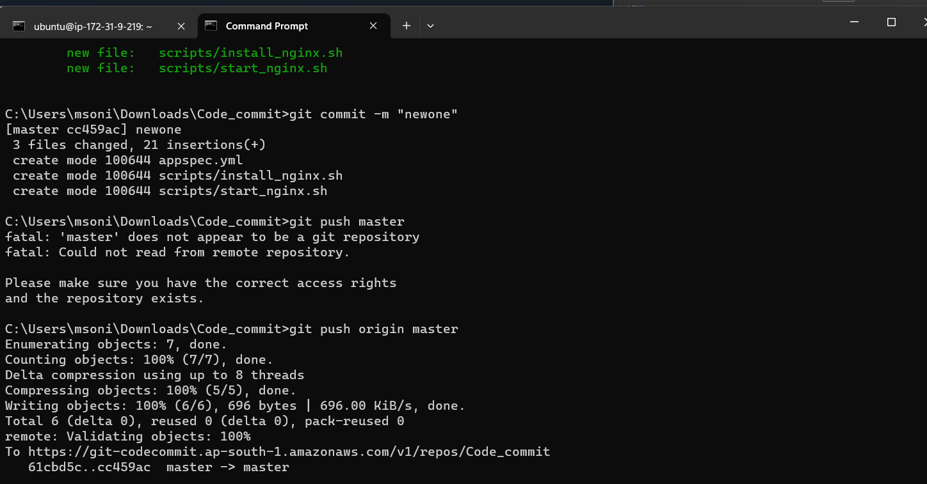

Slide 49
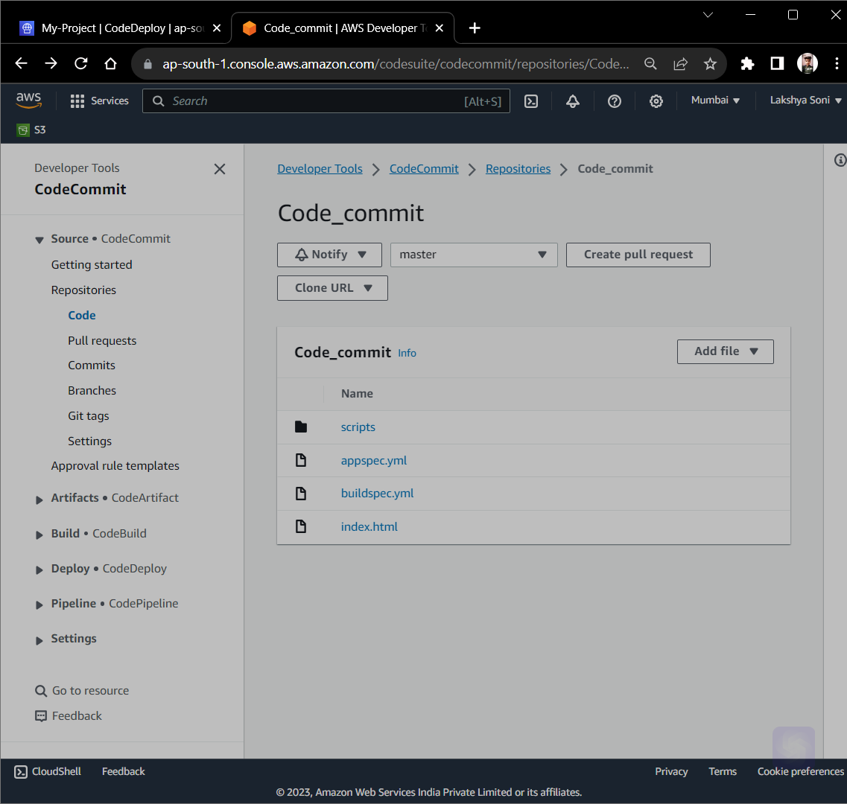

Slide 50
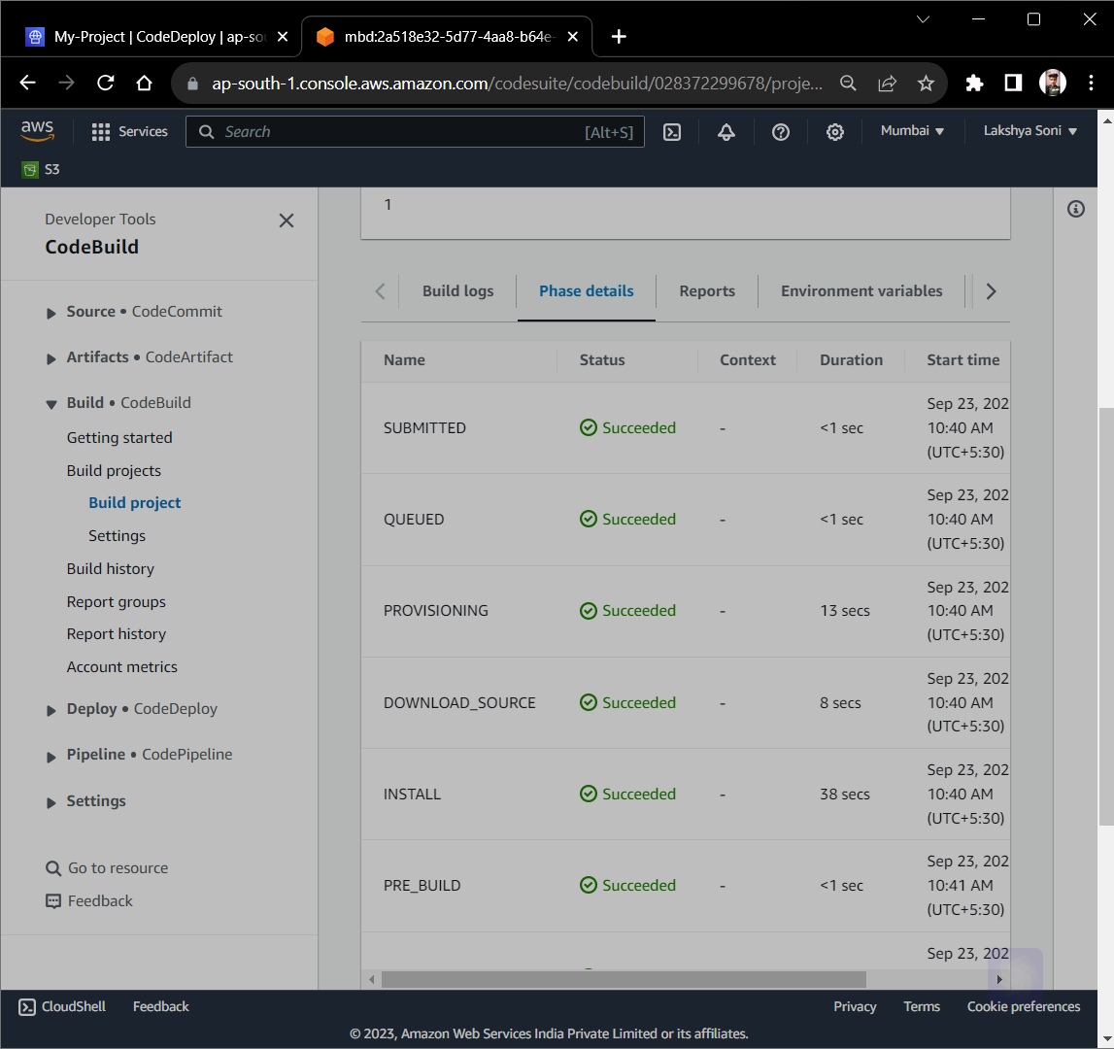

Slide 51
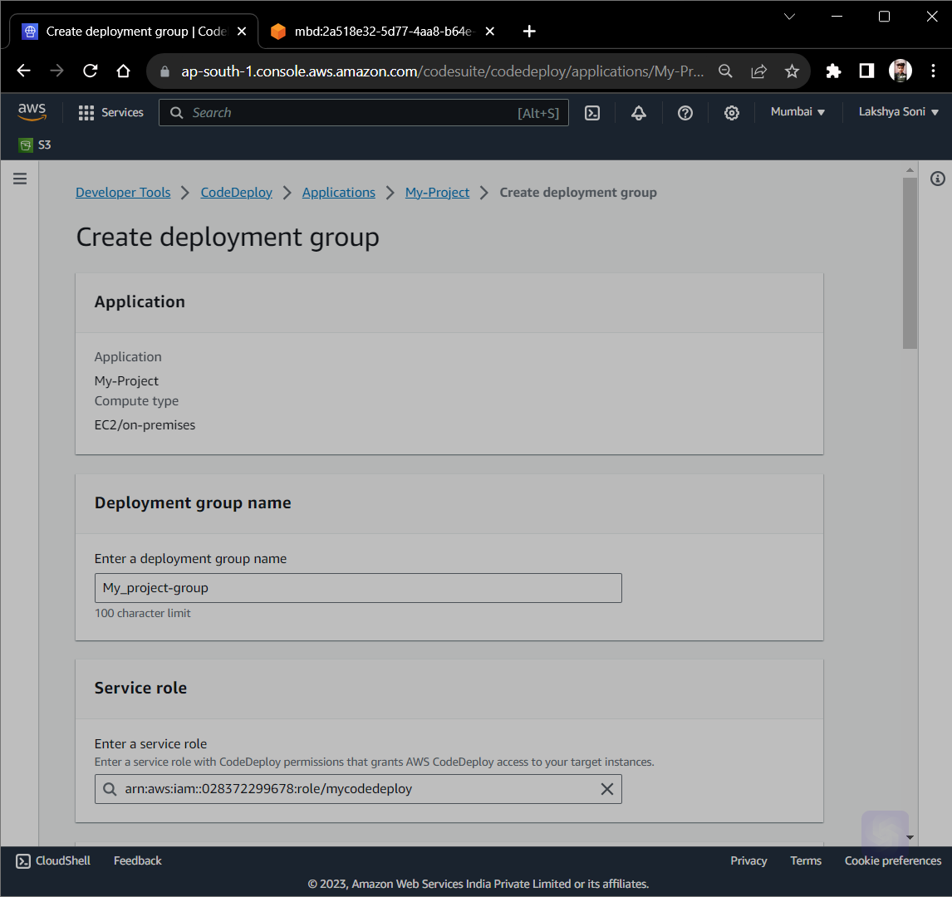
Create Deployment Group from CodeDeploy

Slide 52
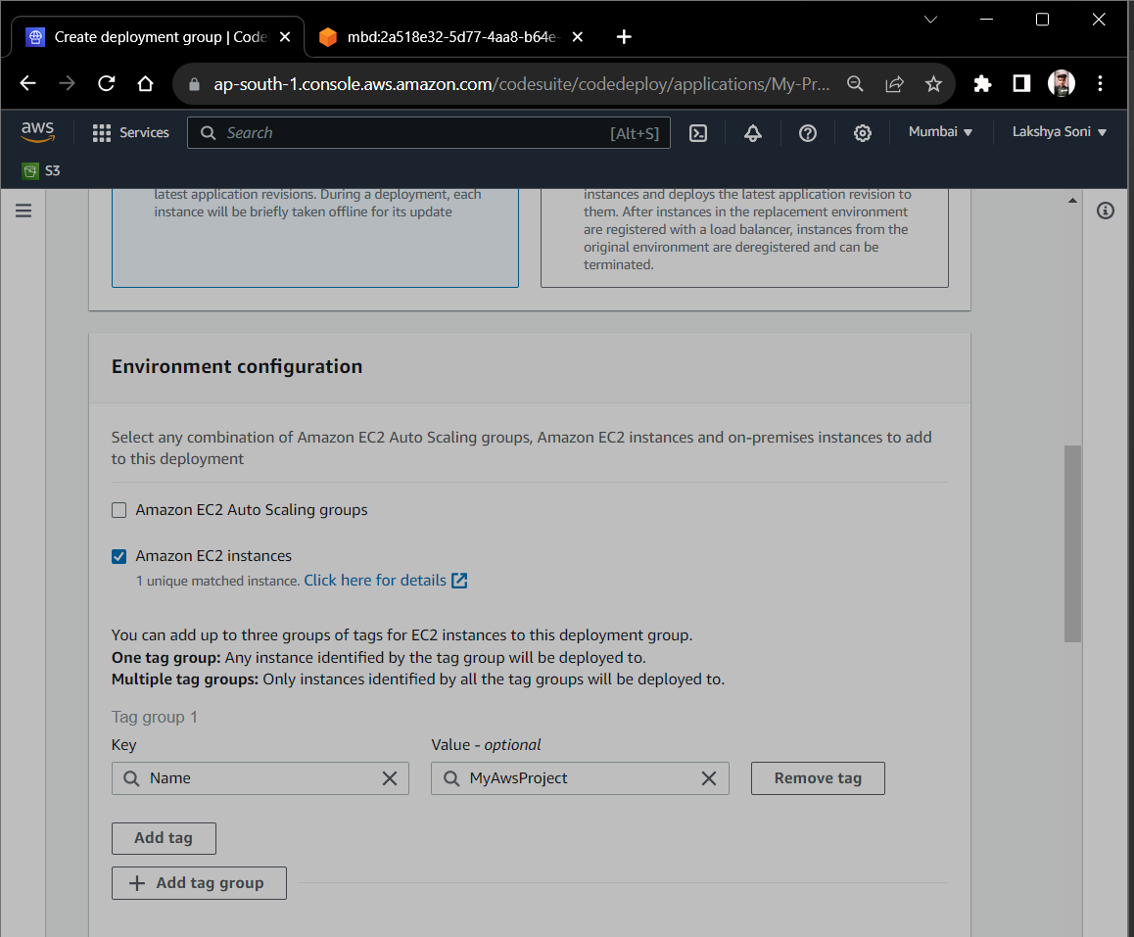

Slide 53


Slide 54


Slide 55

Create Deployment from CodeDeploy

Slide 56


Slide 57


Slide 58


Slide 59

Deployment Works Successfully

Slide 60

Create Pipeline from AWS CodePipeline

Slide 61


Slide 62


Slide 63


Slide 64


Slide 65


Slide 66


Slide 67

Some Changes in Code

Slide 68


Slide 69


Slide 70


Slide 71


